Slide 1
Heads Will Roll!

Slide 2
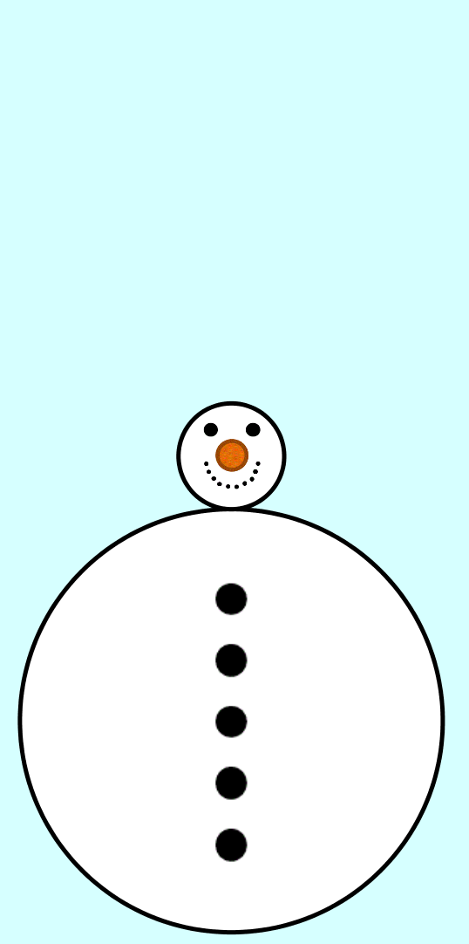
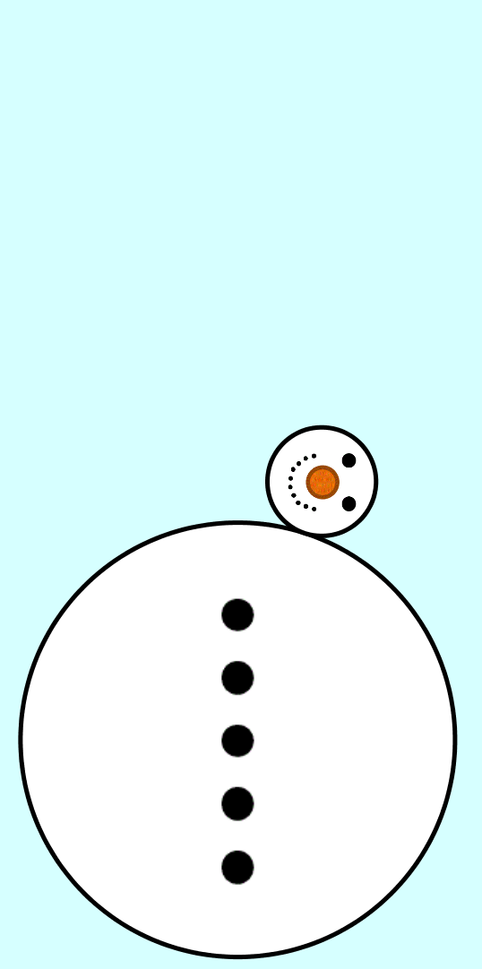

Heads Will Roll!
The head and body of the snowman are circles.
The ratio of their diameters is
$$4:1$$
The head rolls around the body to make one trip back to where it started.
How many times will the head revolve?
Start / Finish Rolling
Drawn
to scale
Notes:
4:1

Slide 3
SIC_65
Heads Will Roll!
The head and body of the snowman are circles.
The ratio of their diameters is
$$4:1$$
The head rolls around the body to make one trip back to where it started.
How many times will the head revolve?
Start / Finish Rolling
Drawn
to scale
Notes:
4:1

Slide 4

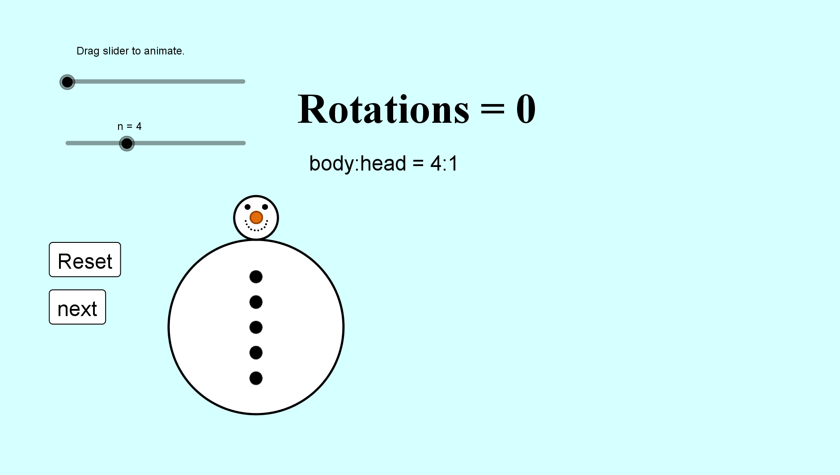
Heads Will Roll!
SIC_65

Slide 5
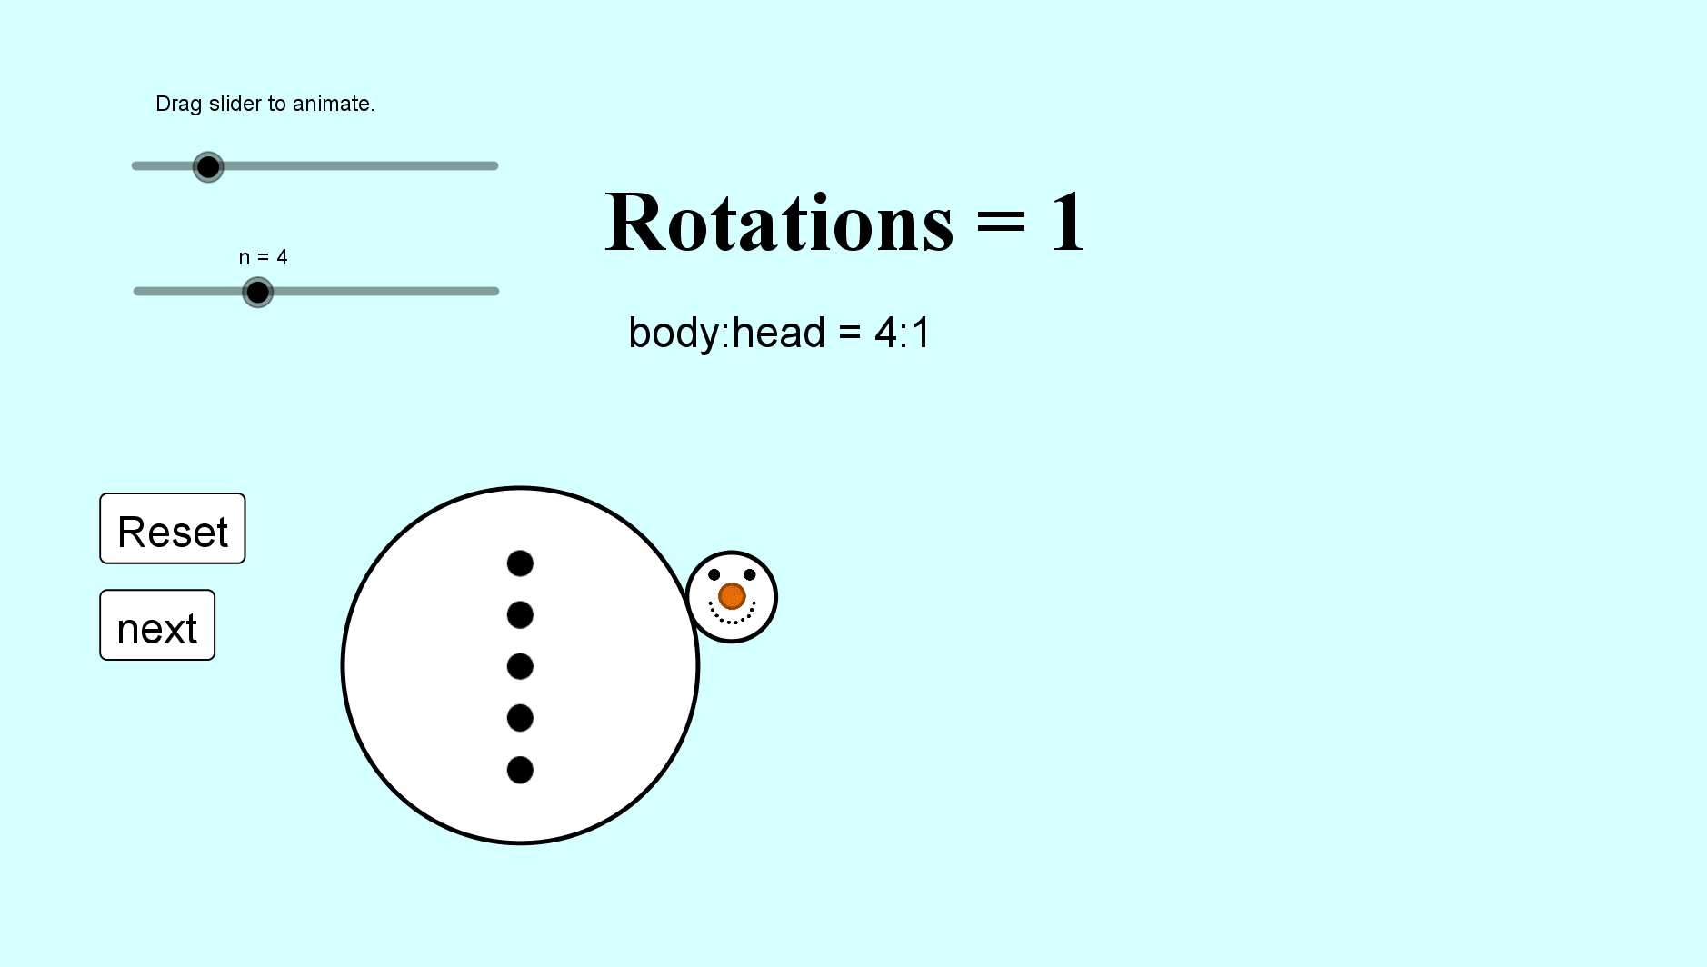
Heads Will Roll!
SIC_65

Slide 6
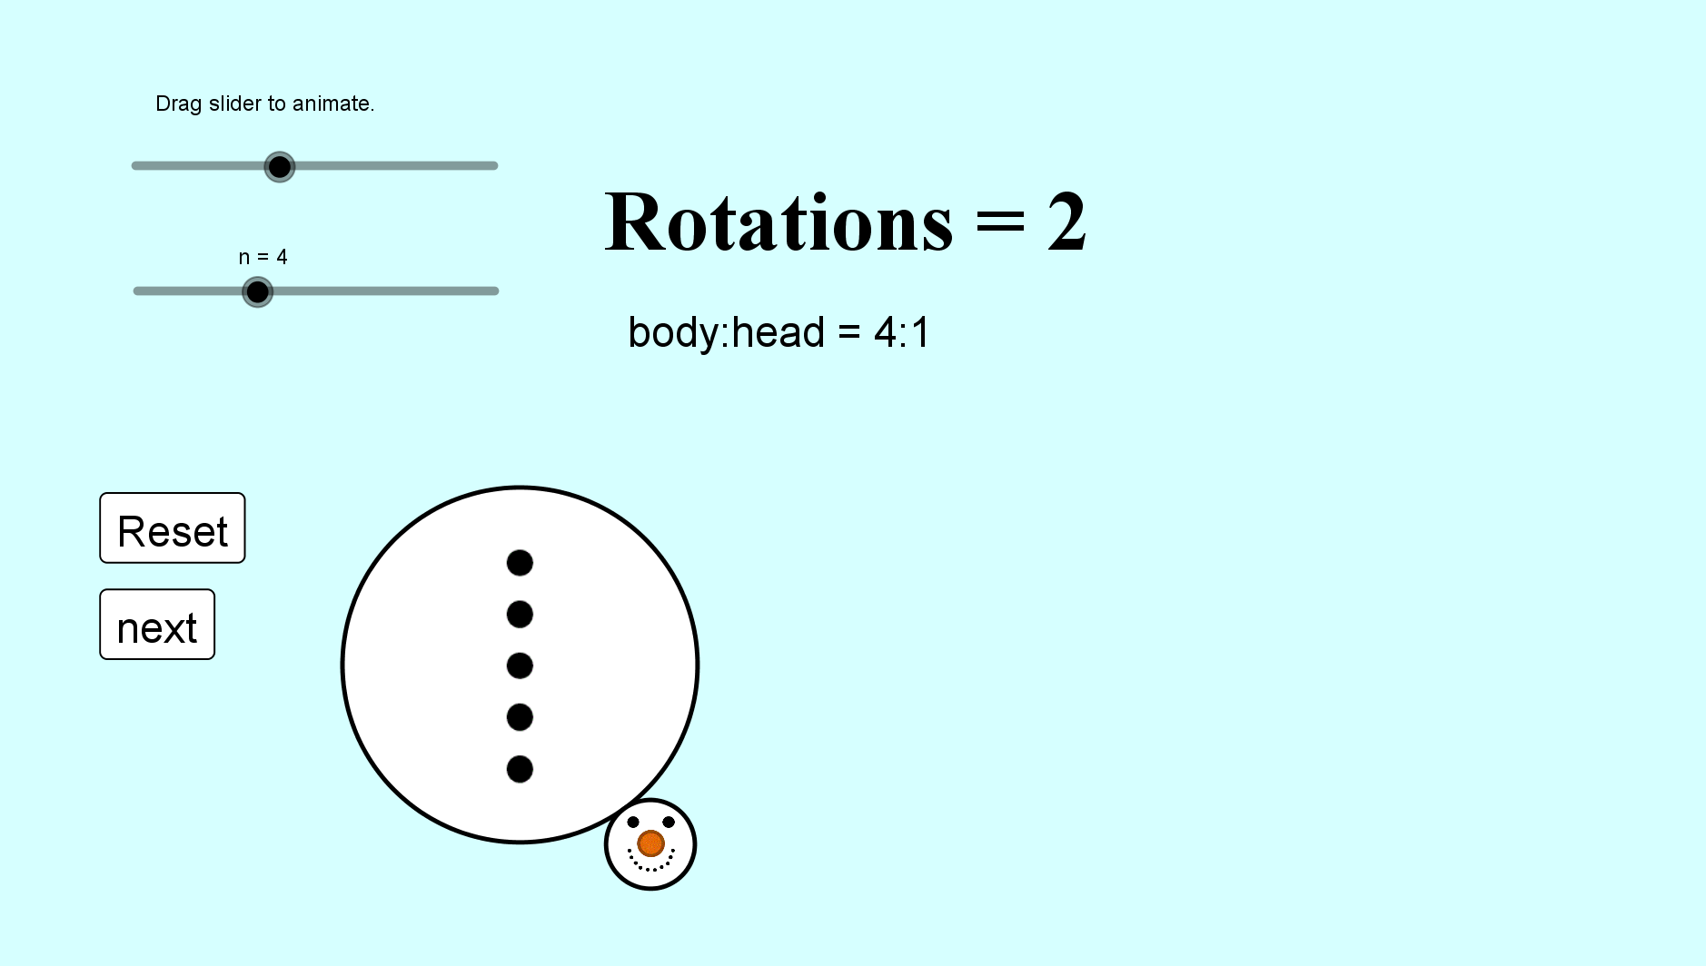
Heads Will Roll!
SIC_65

Slide 7
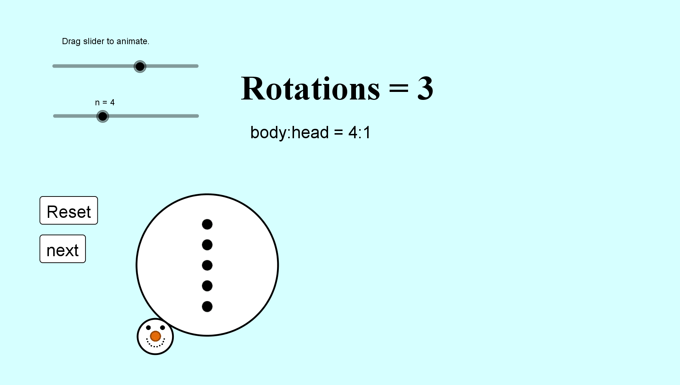
Heads Will Roll!
SIC_65

Slide 8
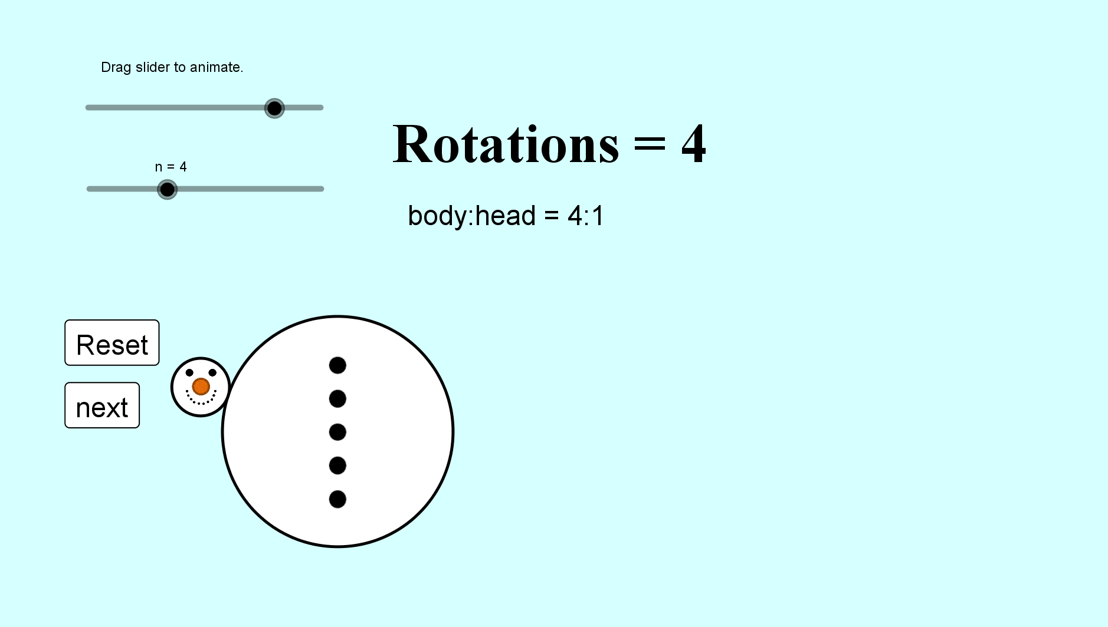
Heads Will Roll!
SIC_65

Slide 9

Heads Will Roll!
SIC_65

Slide 10
Heads Will Roll!
SIC_65

Slide 11
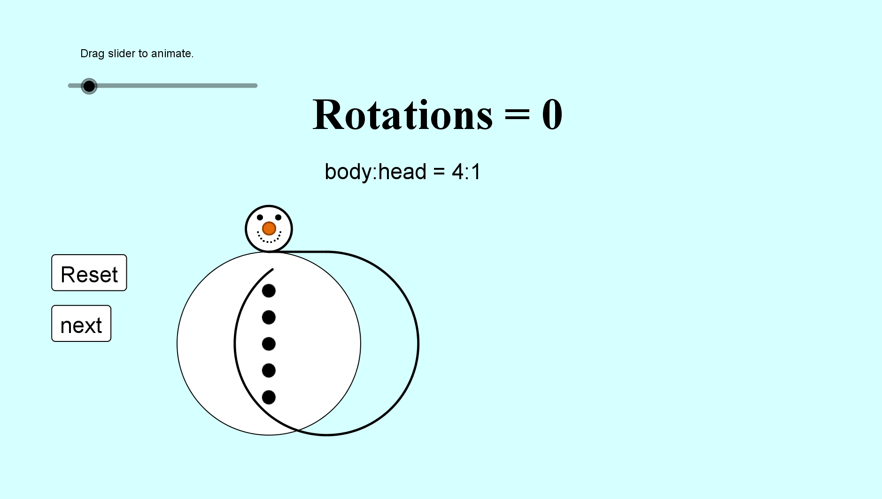
Heads Will Roll!
SIC_65

Slide 12
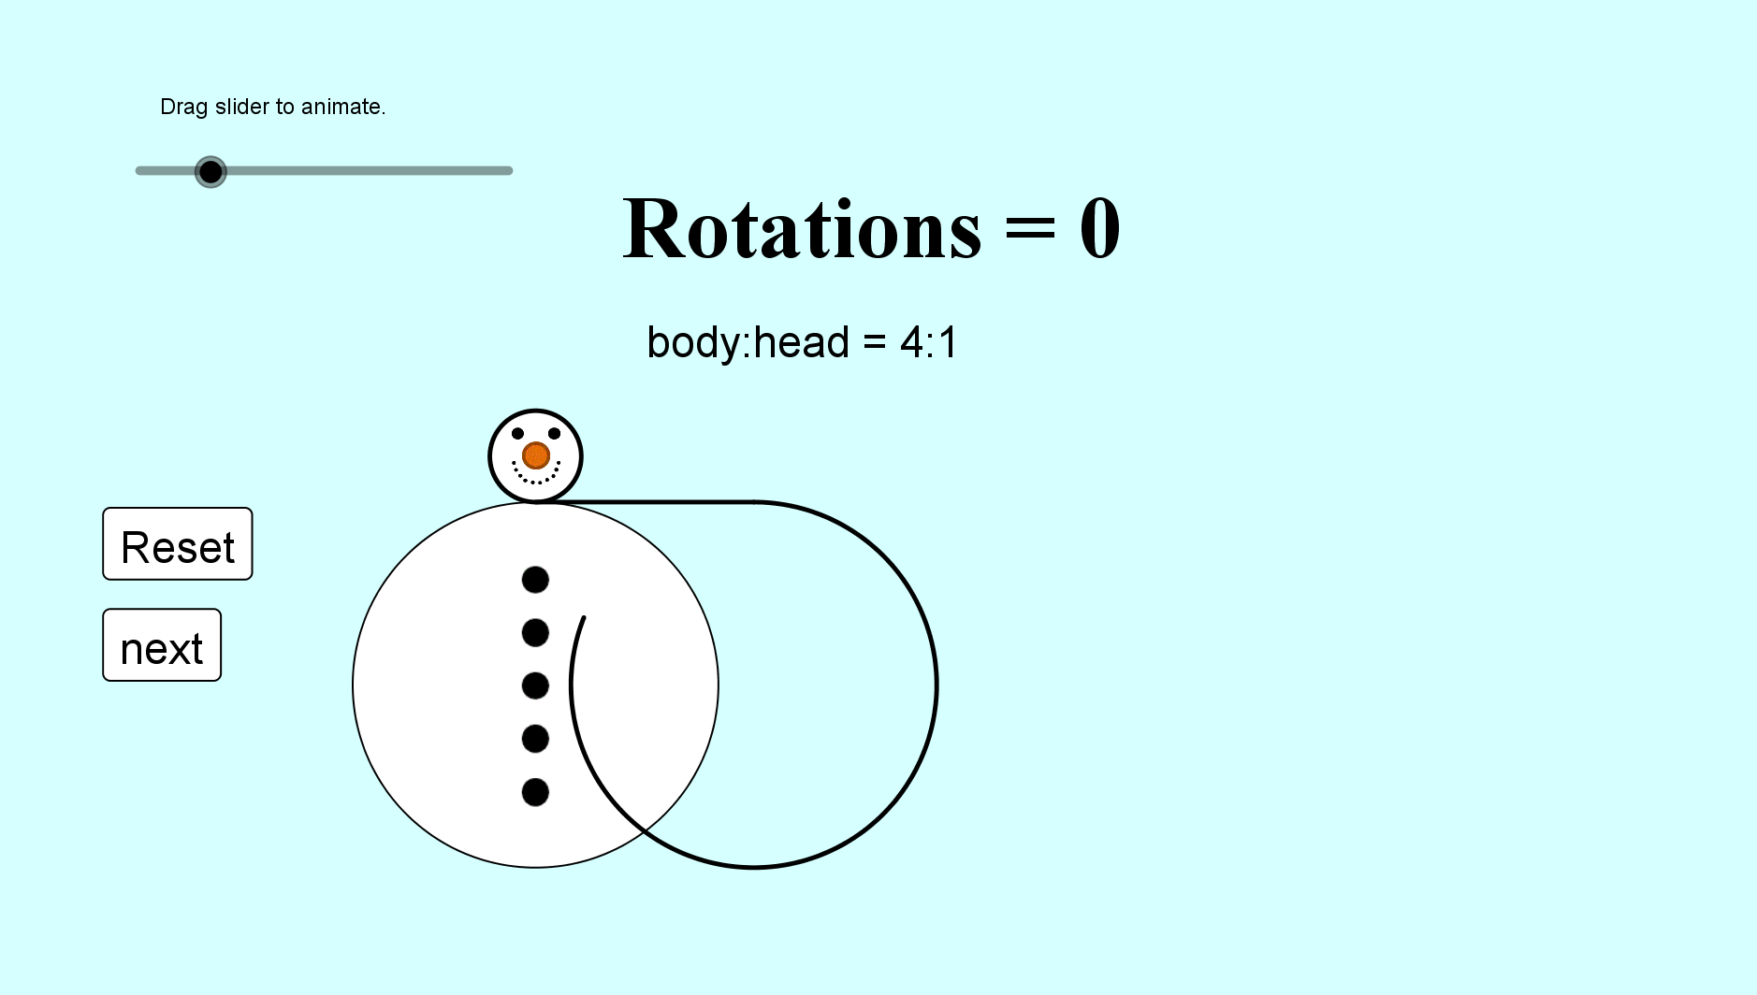
Heads Will Roll!
SIC_65

Slide 13
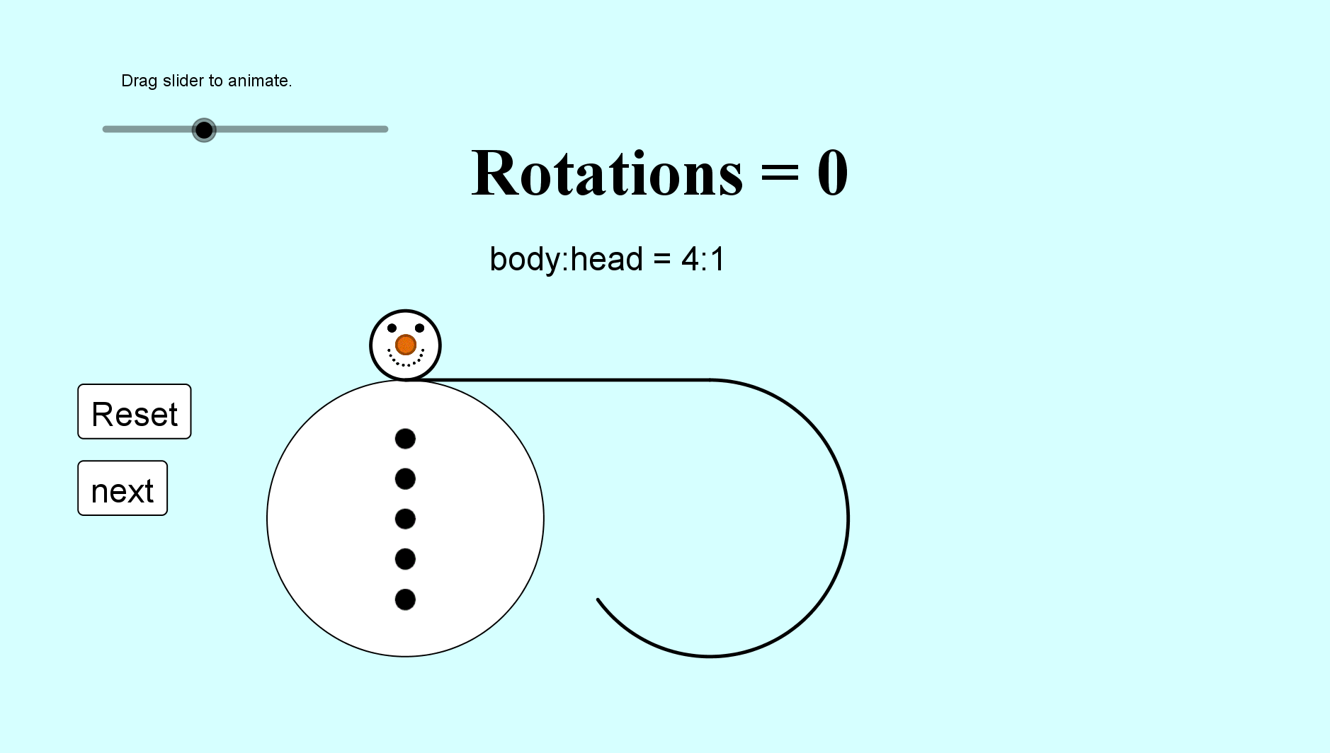
Heads Will Roll!
SIC_65

Slide 14
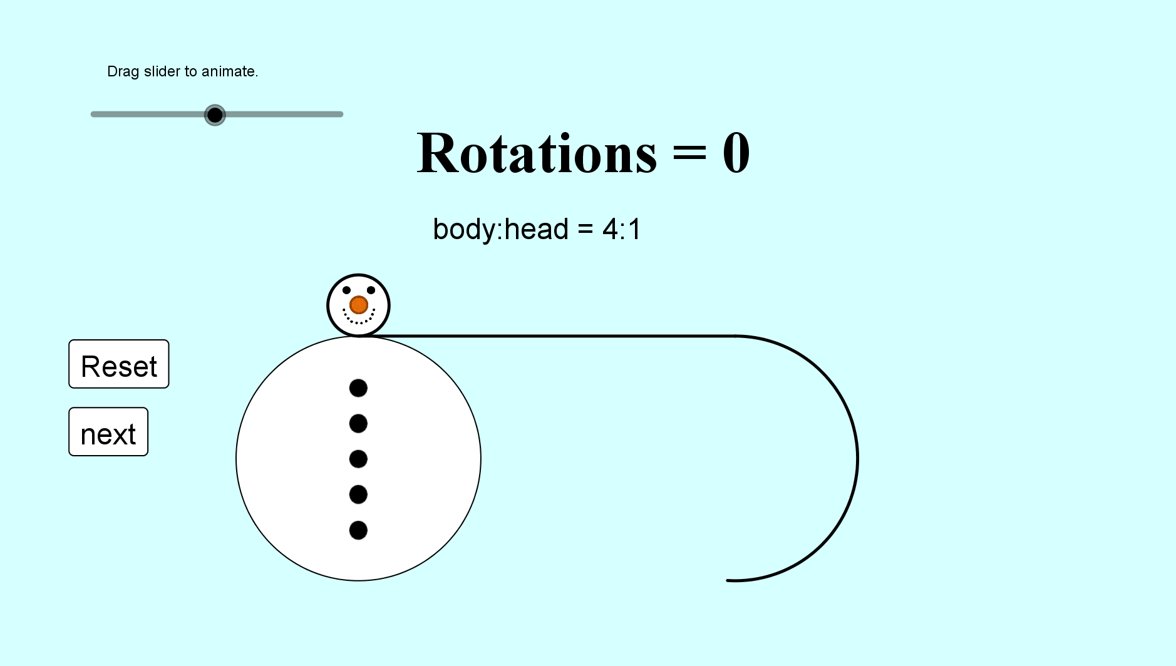
Heads Will Roll!
SIC_65

Slide 15
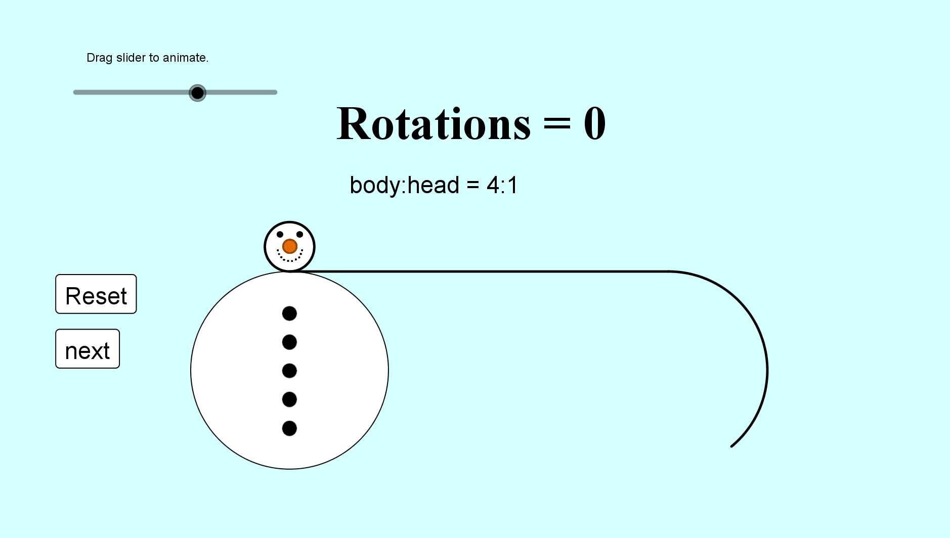
Heads Will Roll!
SIC_65

Slide 16
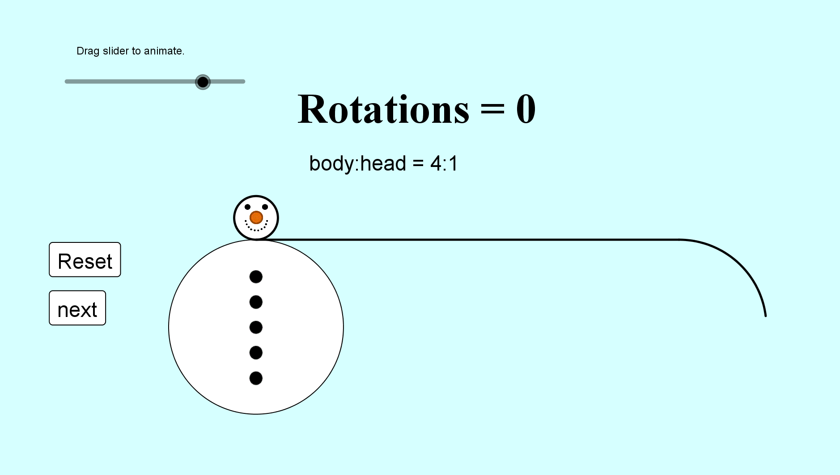
Heads Will Roll!
SIC_65

Slide 17
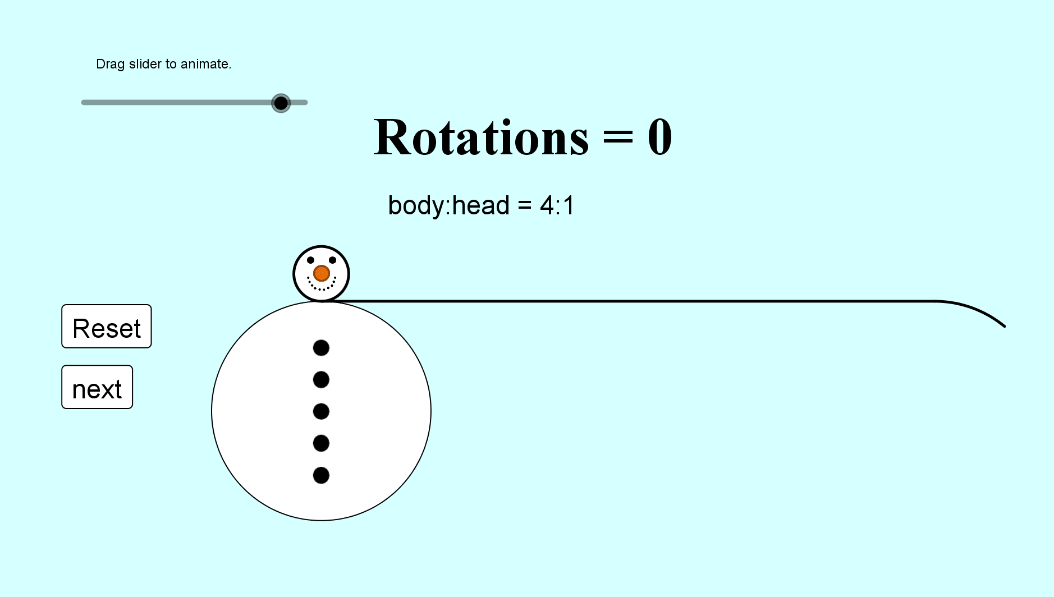
Heads Will Roll!
SIC_65

Slide 18

Heads Will Roll!
SIC_65

Slide 19
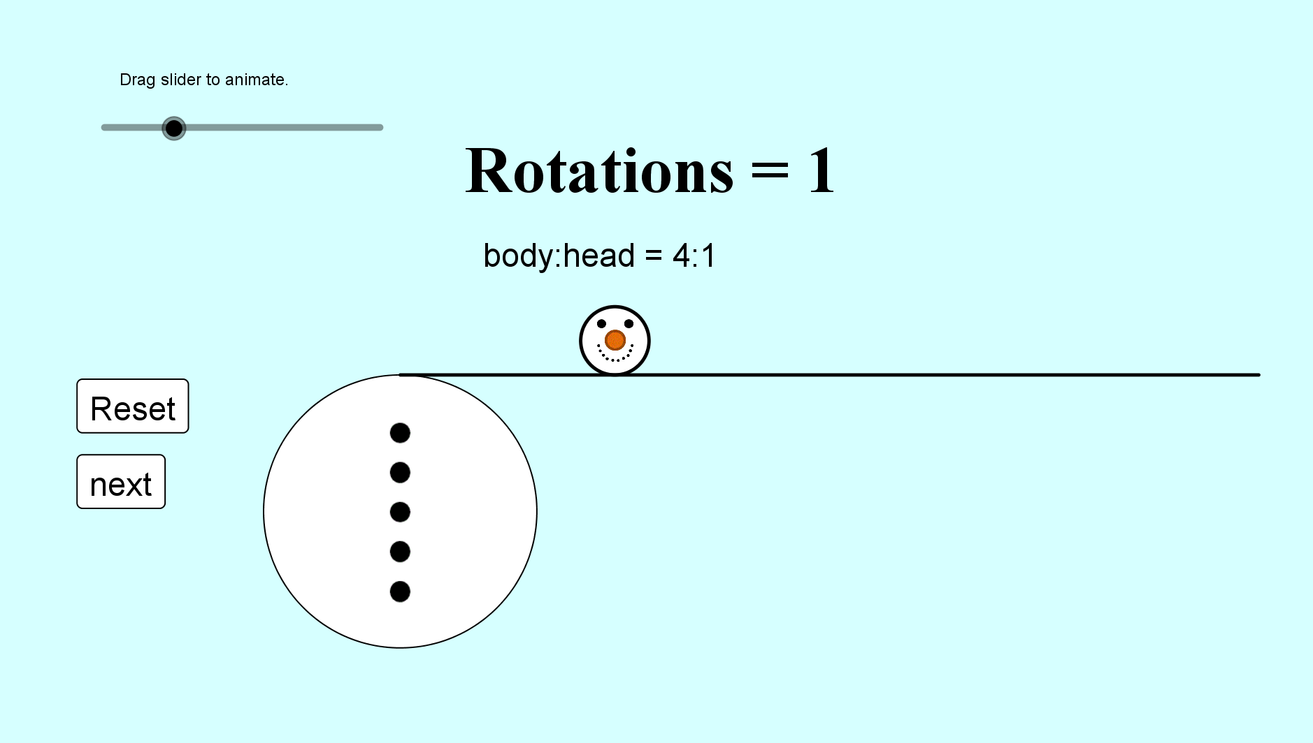
Heads Will Roll!
SIC_65

Slide 20
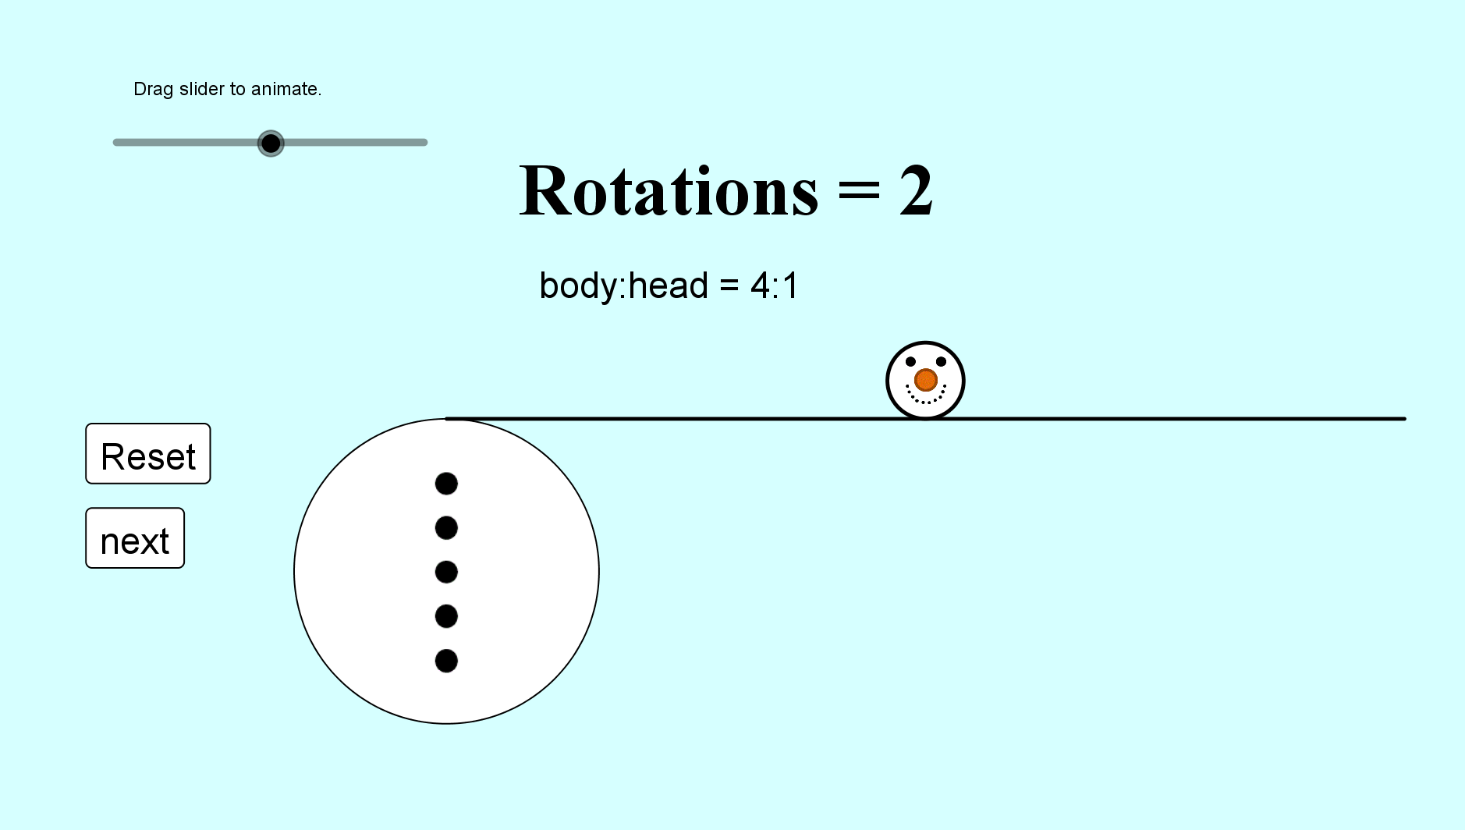
Heads Will Roll!
SIC_65

Slide 21
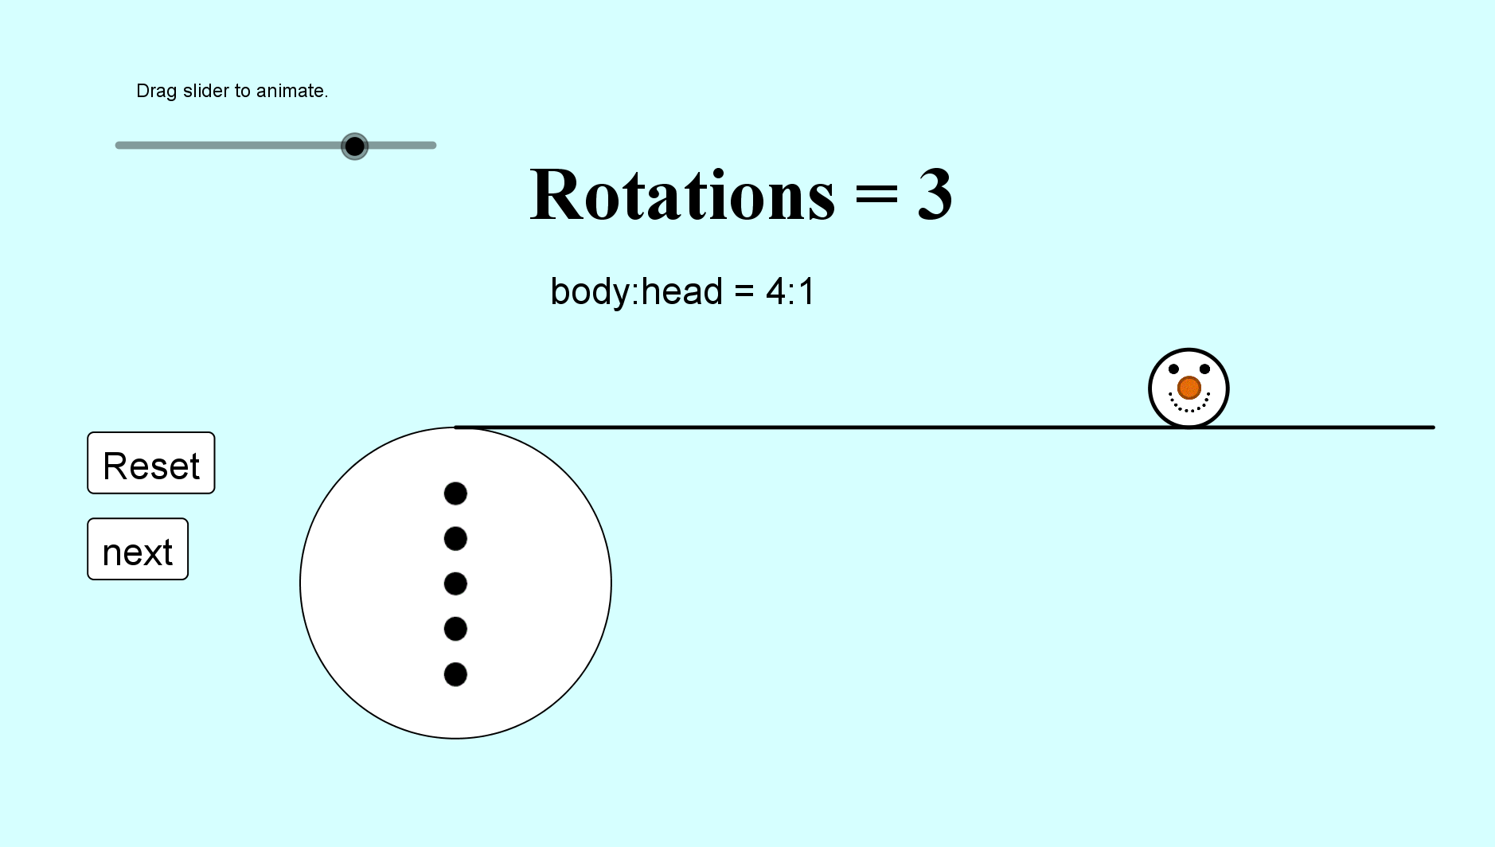
Heads Will Roll!
SIC_65

Slide 22
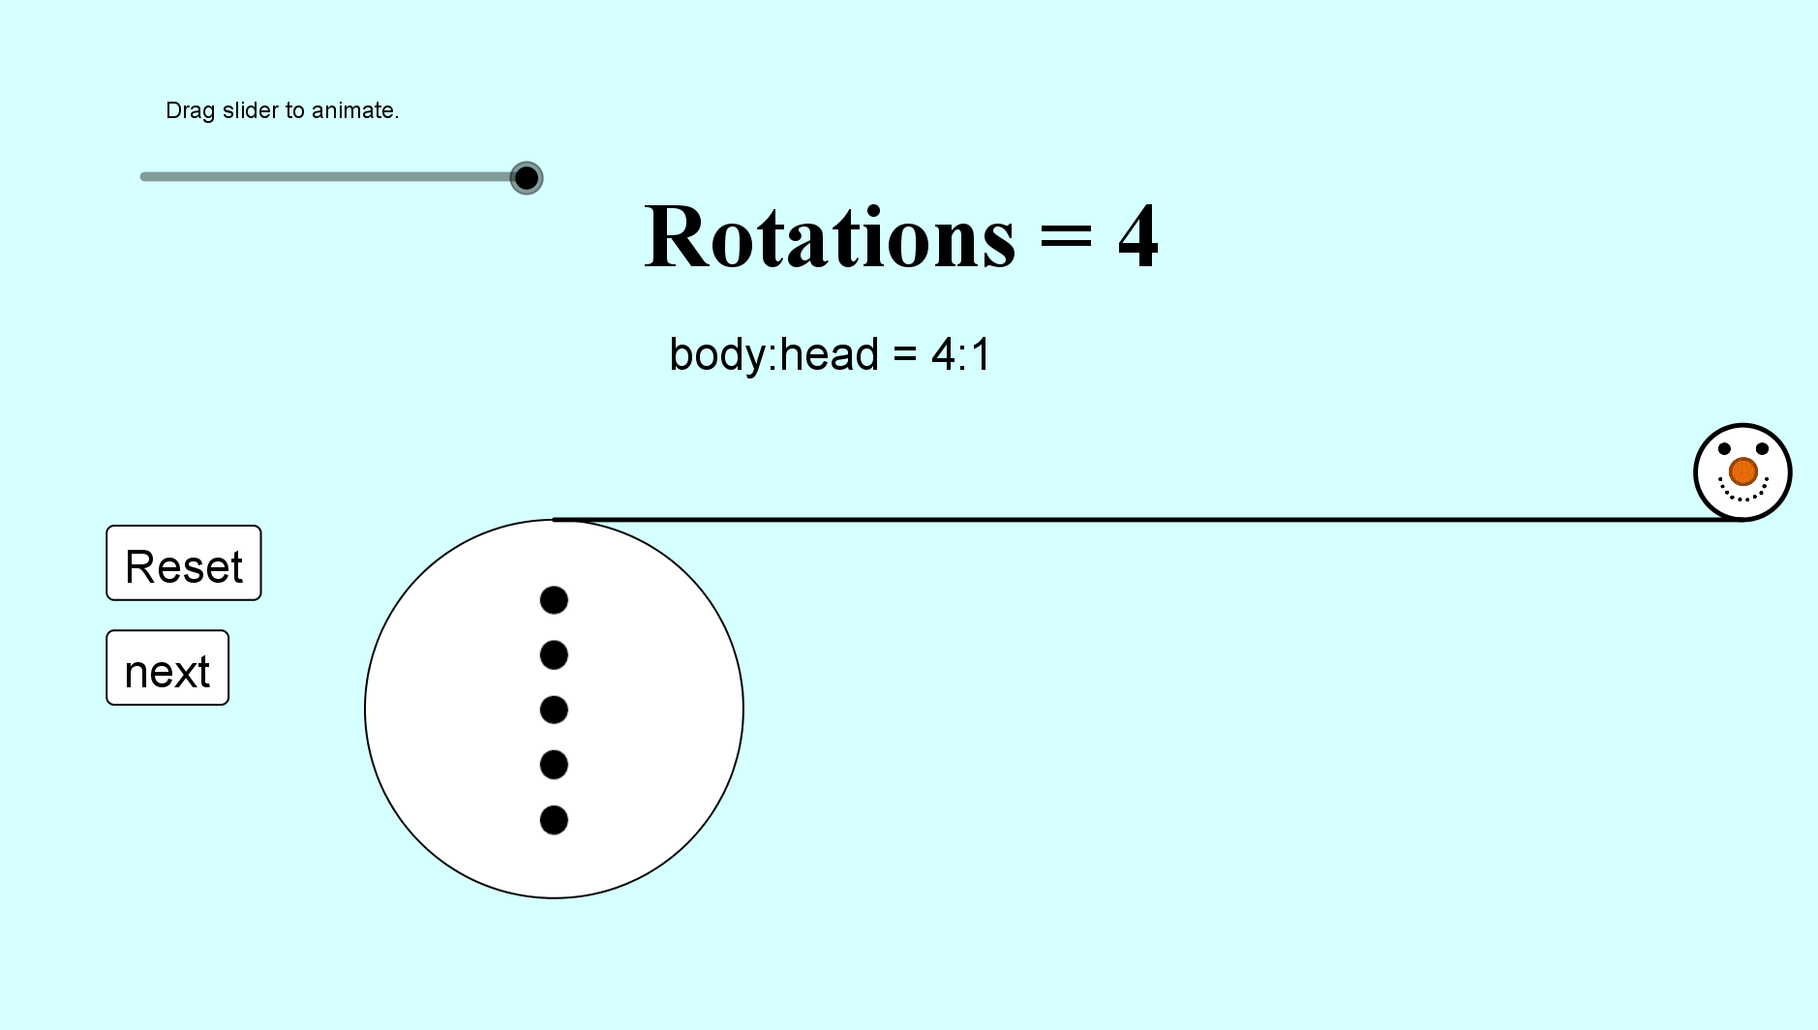
Heads Will Roll!
SIC_65

Slide 23
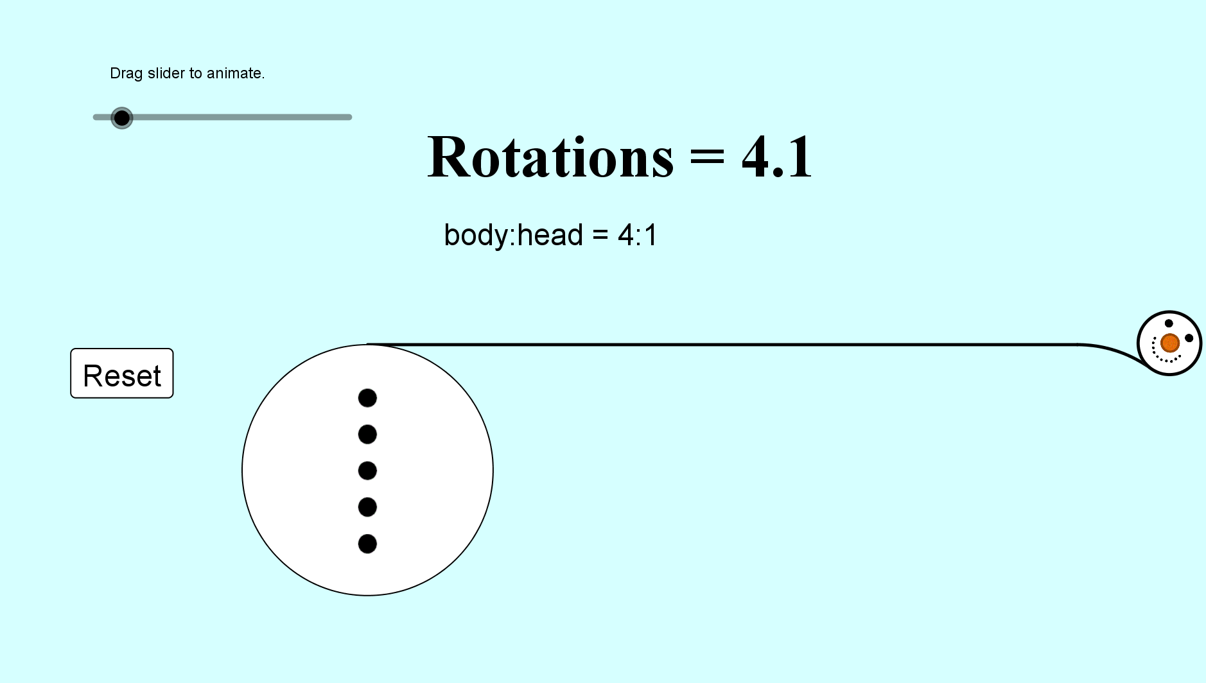
Heads Will Roll!
SIC_65

Slide 24
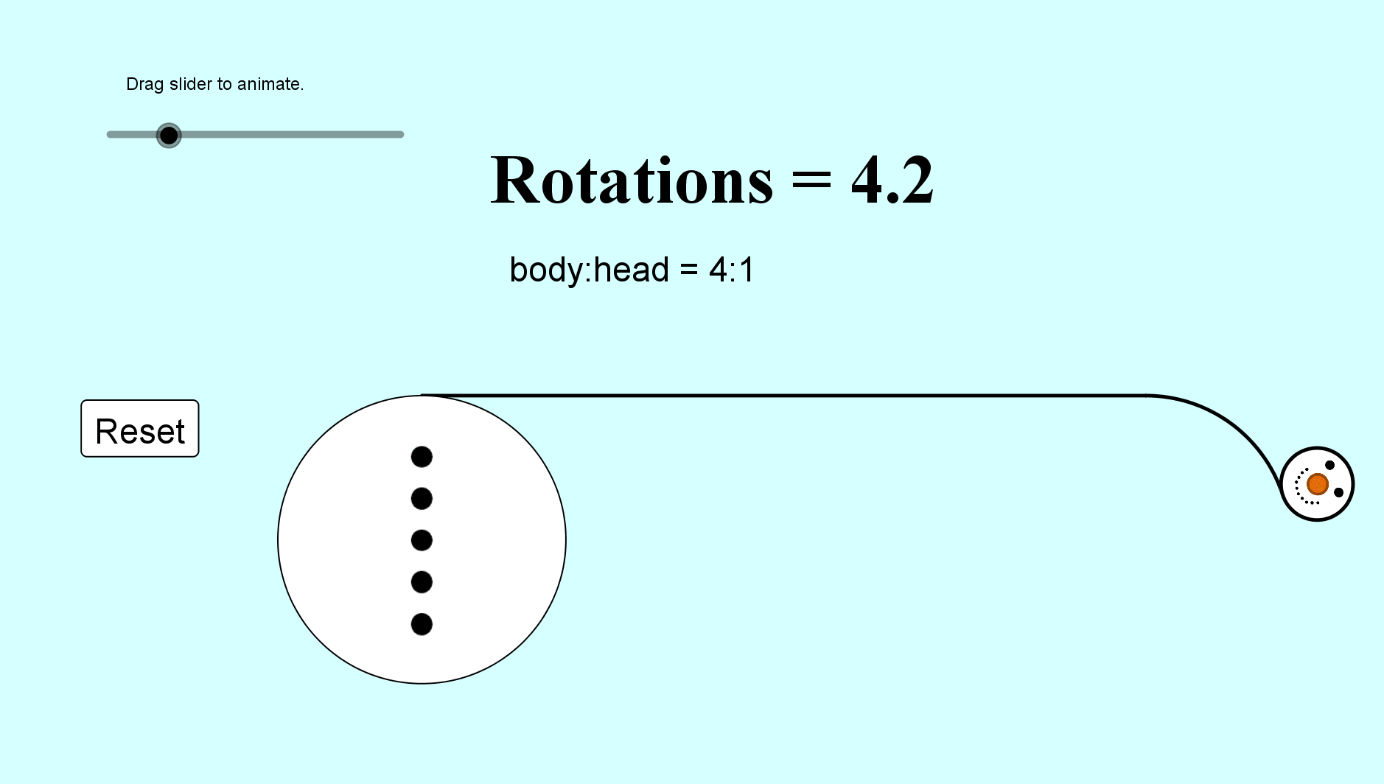
Heads Will Roll!
SIC_65

Slide 25
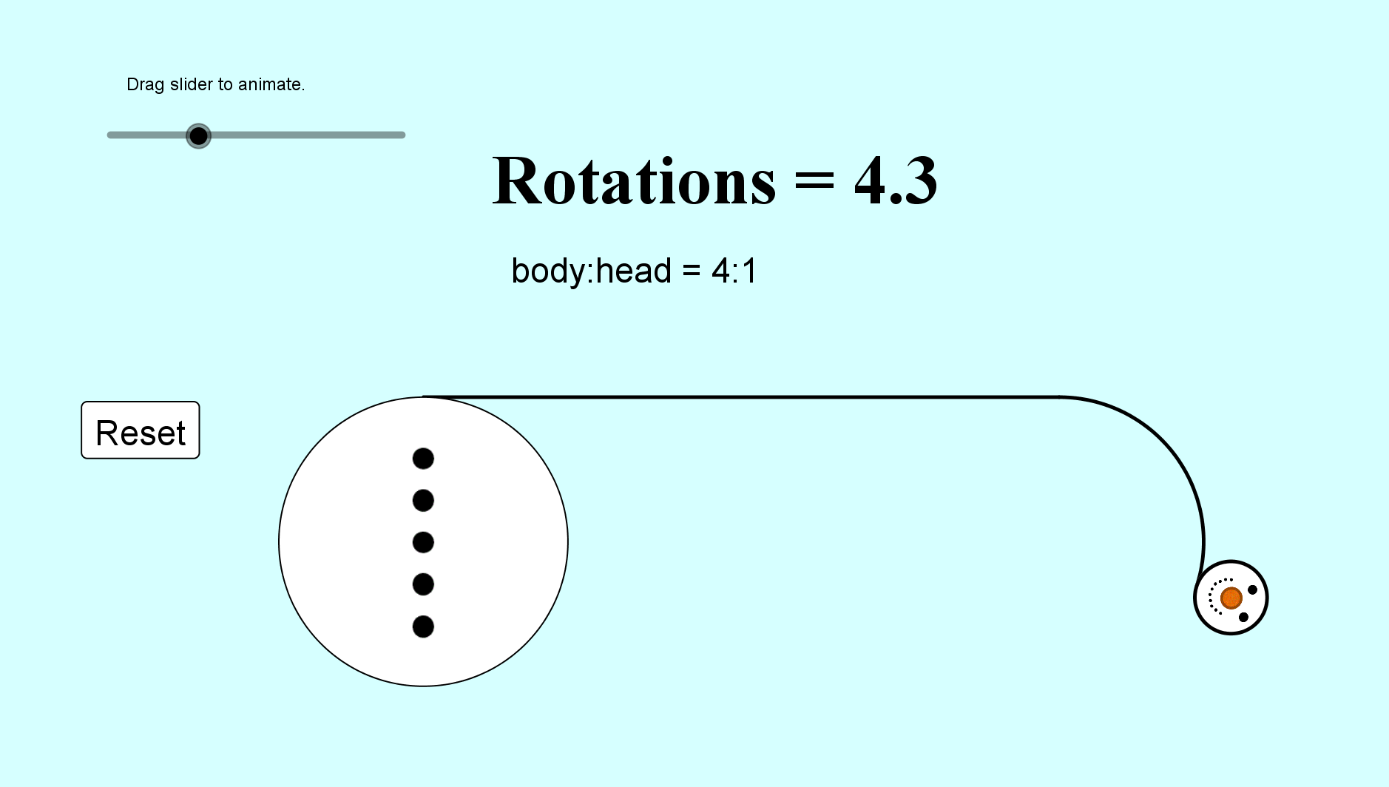
Heads Will Roll!
SIC_65

Slide 26
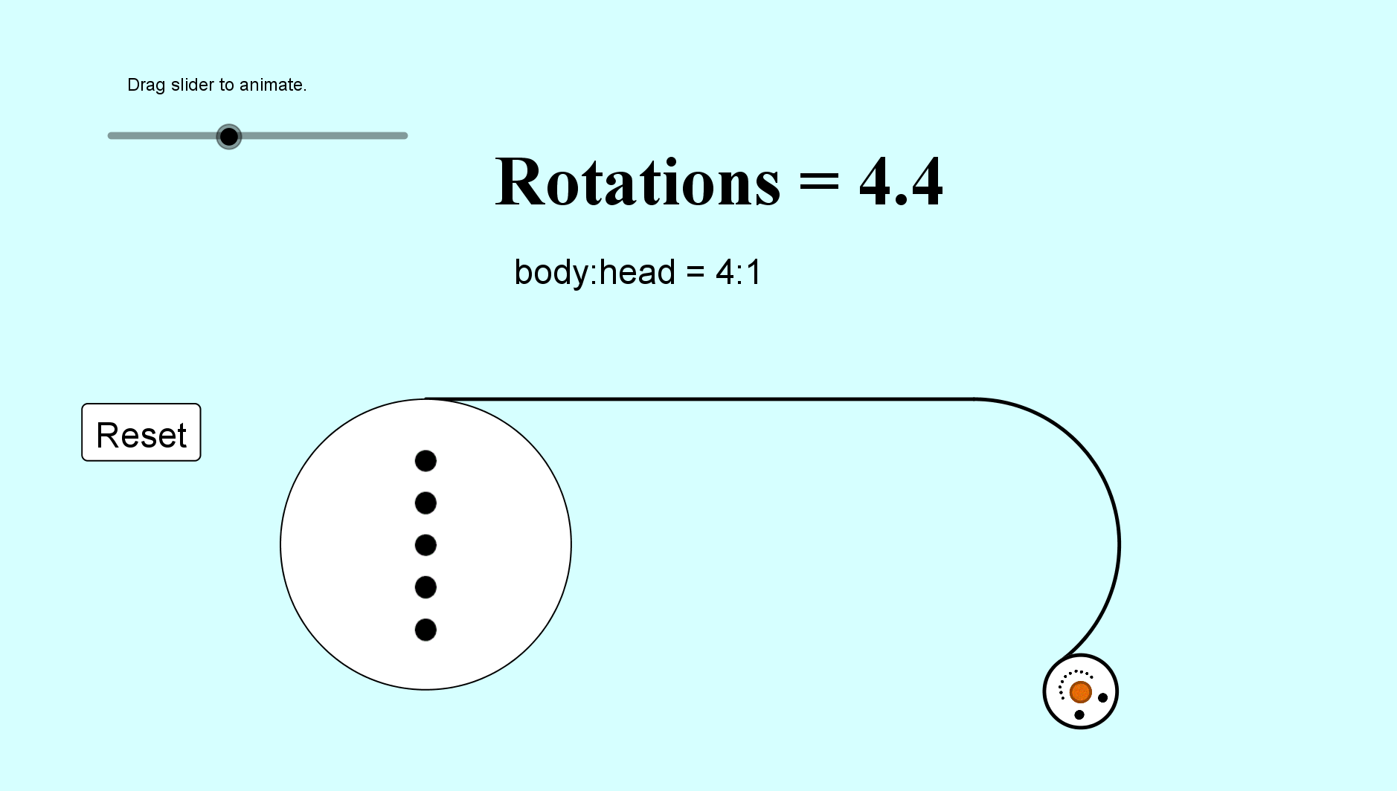
Heads Will Roll!
SIC_65

Slide 27
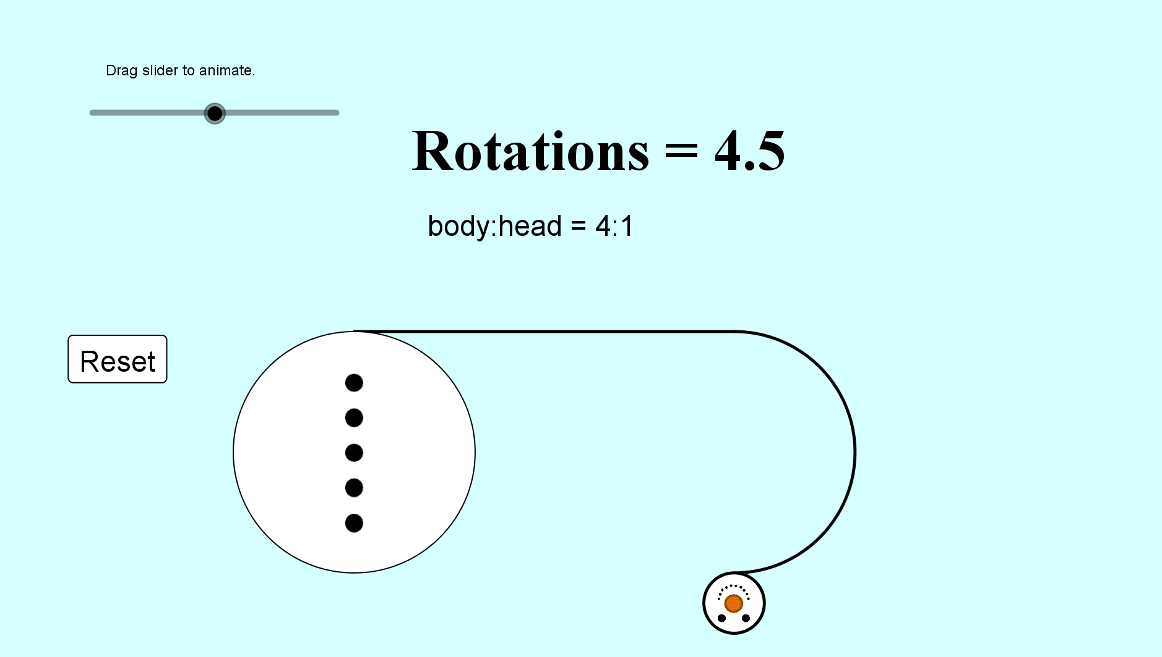
Heads Will Roll!
SIC_65

Slide 28
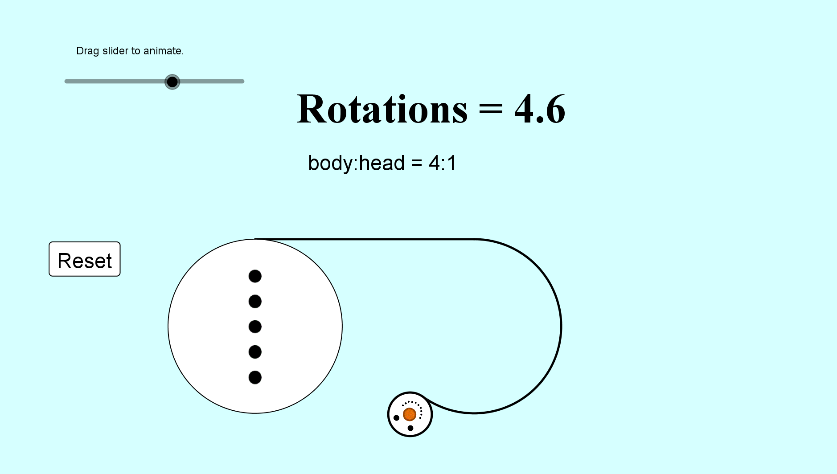
Heads Will Roll!
SIC_65

Slide 29
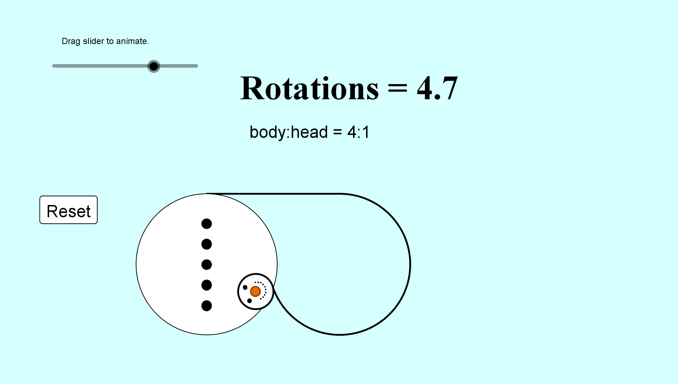
Heads Will Roll!
SIC_65

Slide 30
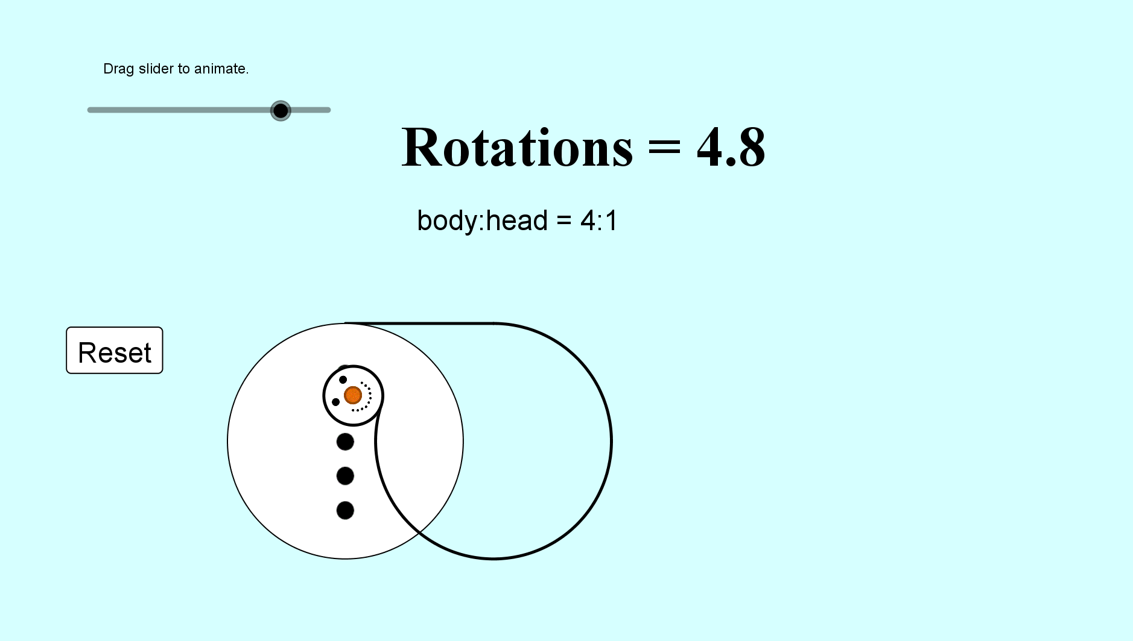
Heads Will Roll!
SIC_65

Slide 31
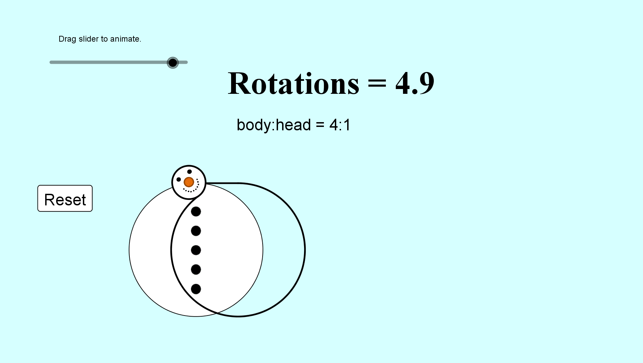
Heads Will Roll!
SIC_65

Slide 32
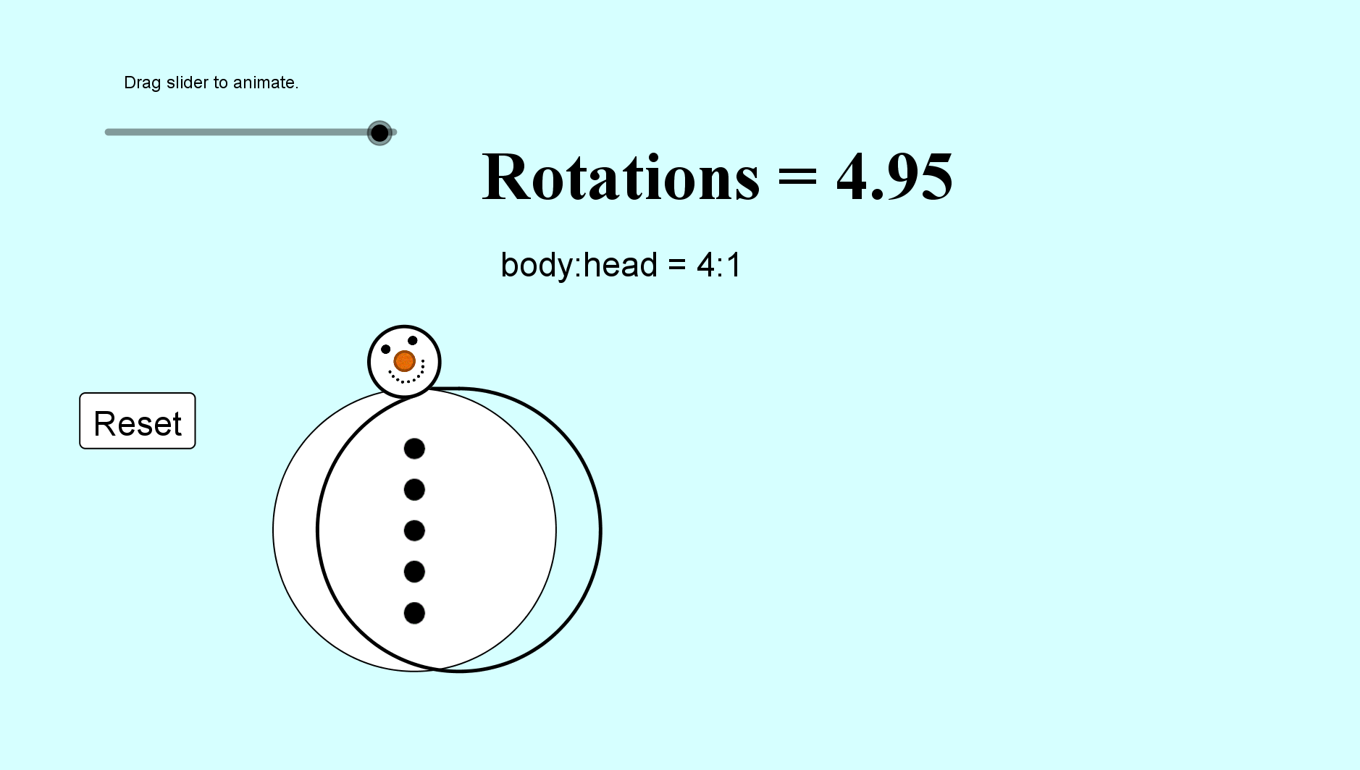
Heads Will Roll!
SIC_65

Slide 33
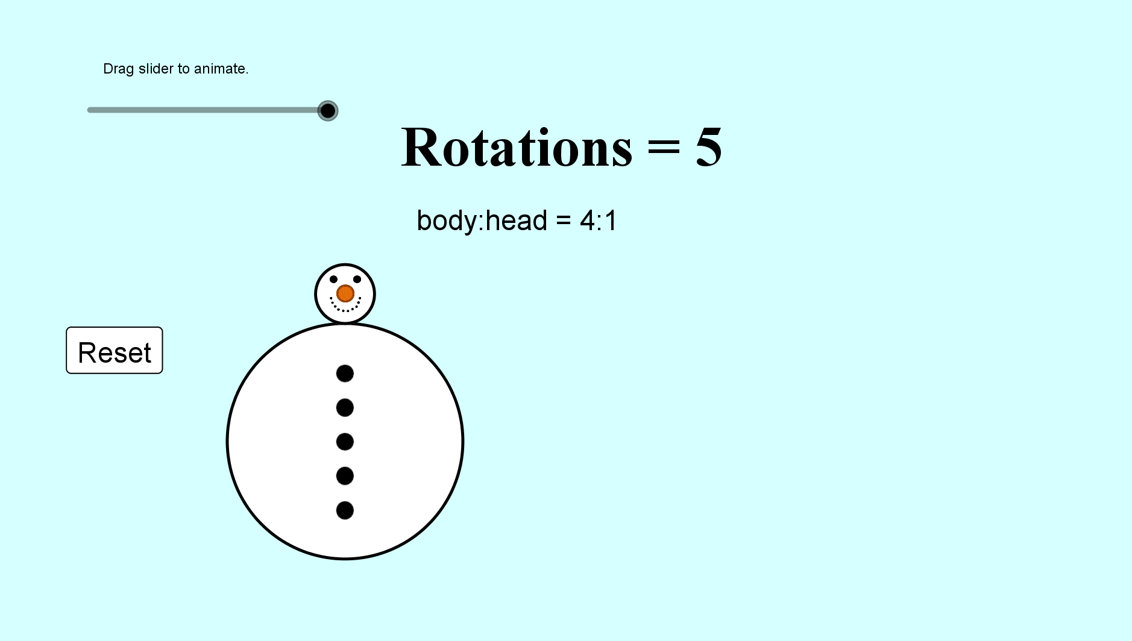
Heads Will Roll!
SIC_65

Slide 34
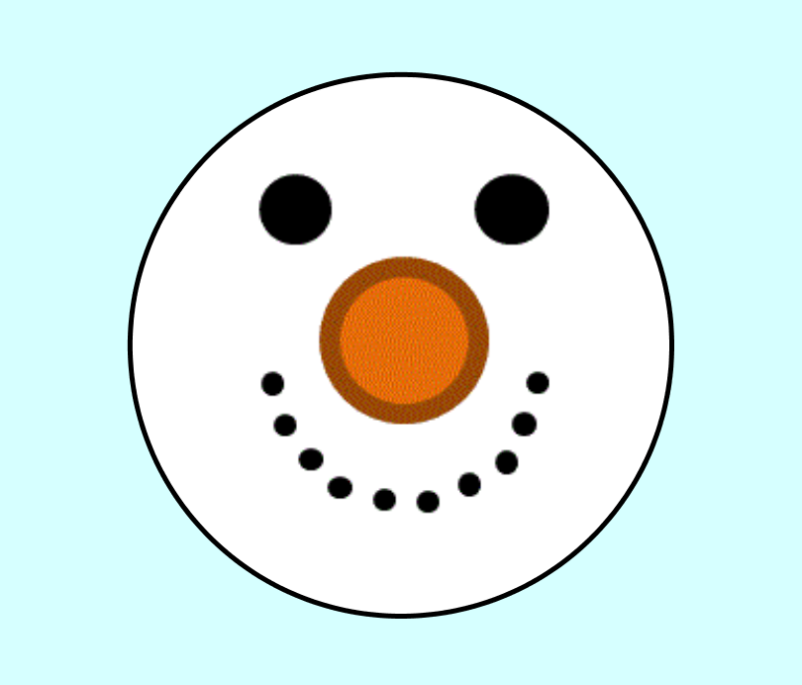

Slide 36
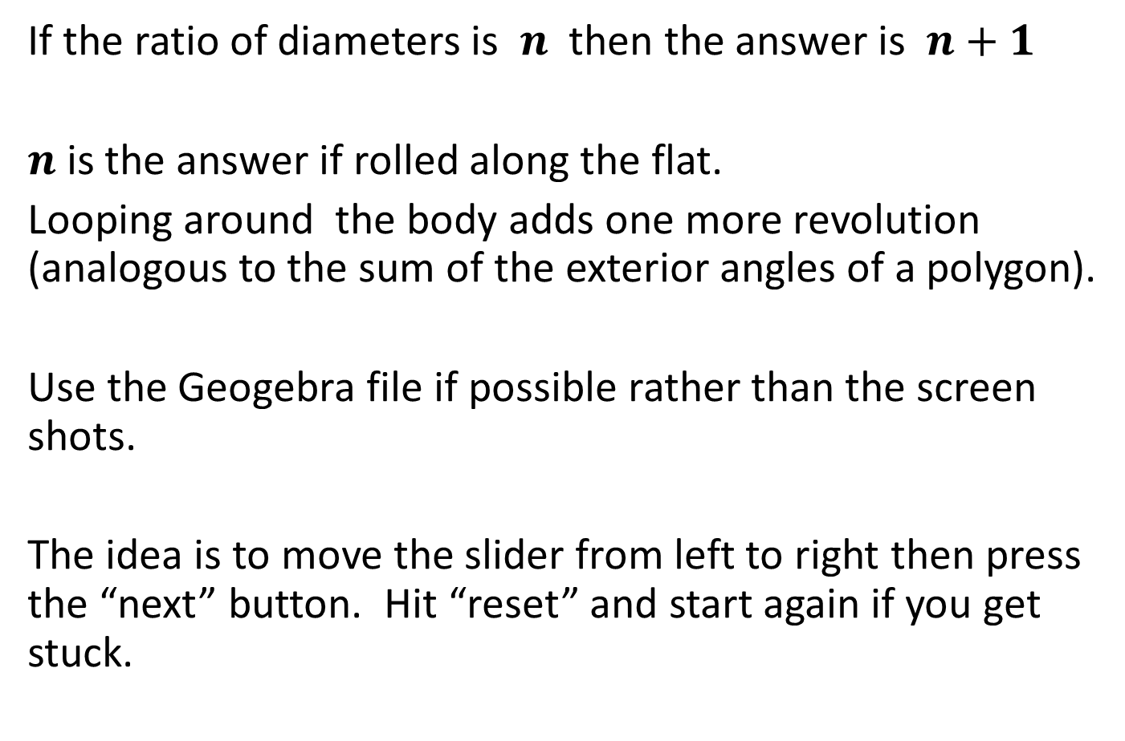
Note to teacher
If the ratio of diameters is $n$ then the answer is $n+1$
$n$ is the answer if rolled along the flat.
Looping around the body adds one more revolution (analogous to the sum of the exterior angles of a polygon).
Use the Geogebra file if possible rather than the screen shots.
The idea is to move the slider from left to right then press the “next” button. Hit “reset” and start again if you get stuck.

Slide 37
RESOURCES

Slide 38
SIC_65
Heads Will Roll!
The head and body of the snowman are circles.
The ratio of their diameters is
$$4:1$$
The head rolls around the body to make one trip back to where it started.
How many times will the head revolve?
Start / Finish Rolling
Drawn
to scale
Notes:
4:1

Slide 39
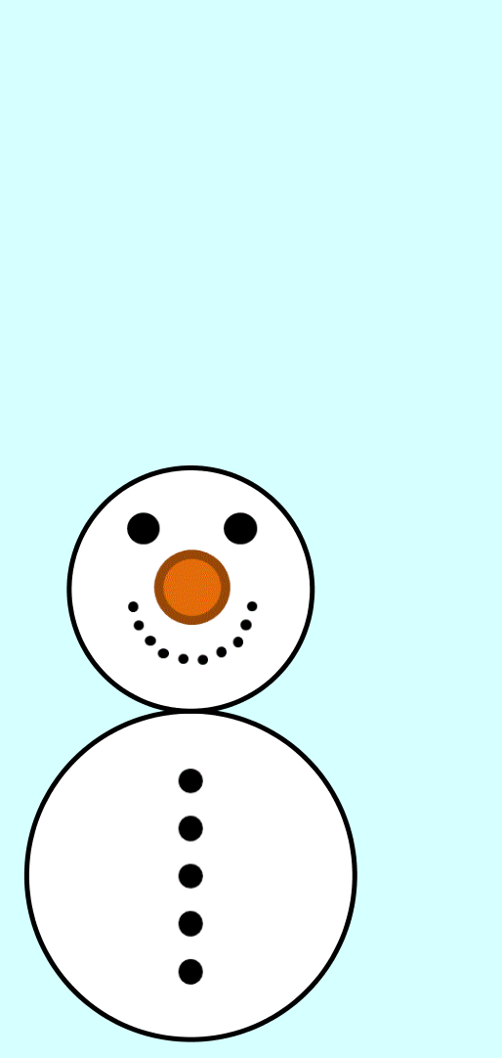

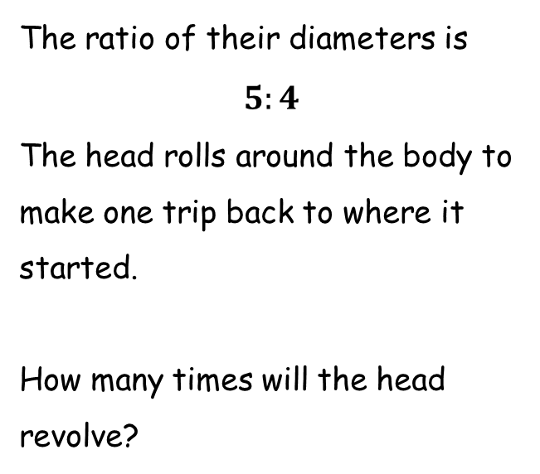
SIC_65
Heads Will Roll!
The head and body of the snowman are circles.
The ratio of their diameters is
$$5:4$$
The head rolls around the body to make one trip back to where it started.
How many times will the head revolve?
Start / Finish Rolling
Drawn
to scale
Notes:
5:4

Slide 40
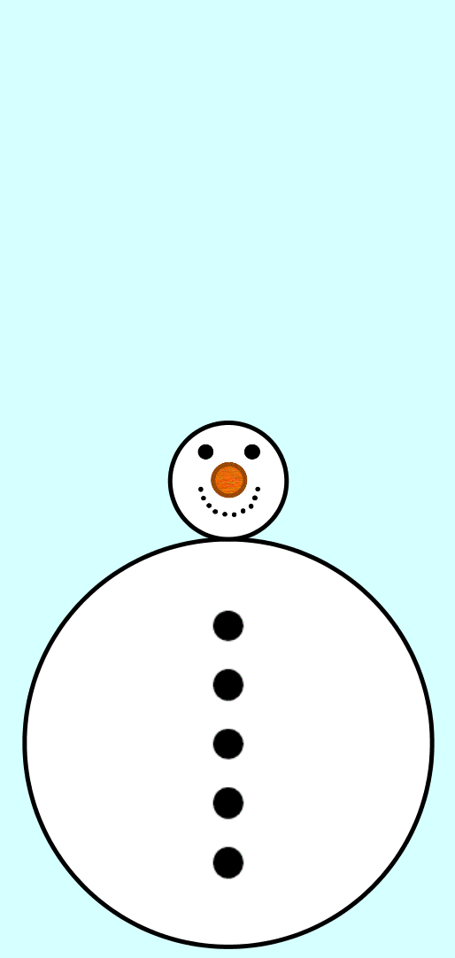
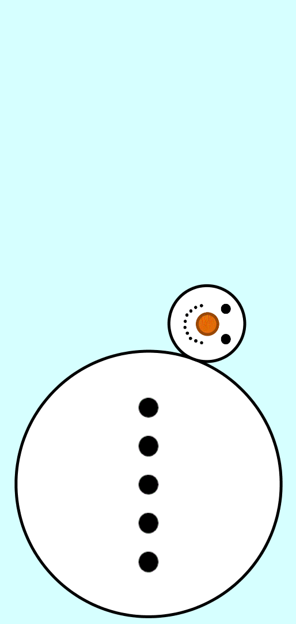
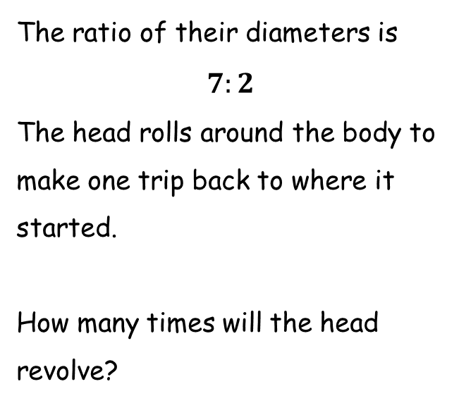
SIC_65
Heads Will Roll!
The head and body of the snowman are circles.
The ratio of their diameters is
$$7:2$$
The head rolls around the body to make one trip back to where it started.
How many times will the head revolve?
Start / Finish Rolling
Drawn
to scale
Notes:
7:2

Slide 41
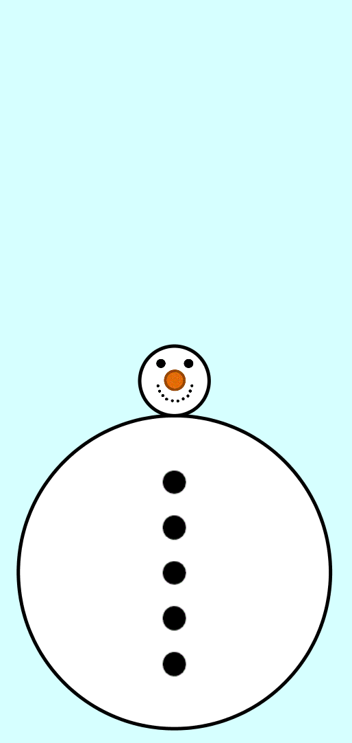
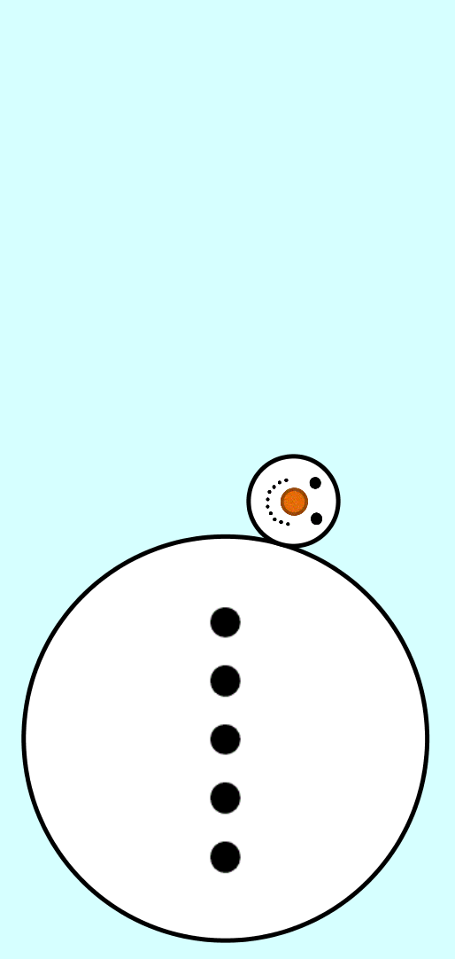
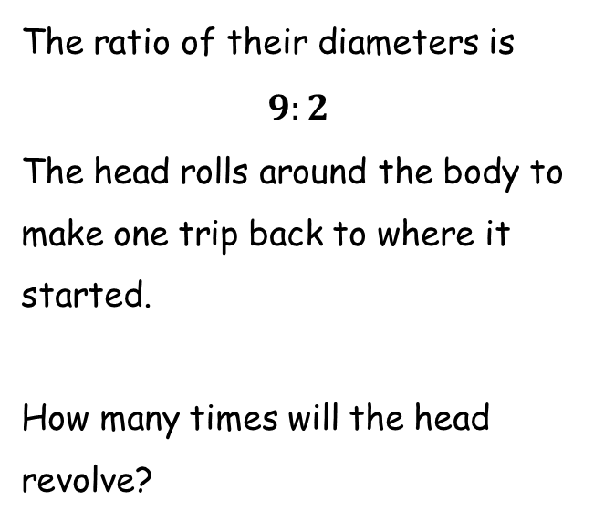
SIC_65
Heads Will Roll!
The head and body of the snowman are circles.
The ratio of their diameters is
$$9:2$$
The head rolls around the body to make one trip back to where it started.
How many times will the head revolve?
Start / Finish Rolling
Drawn
to scale
Notes:
9:2

Slide 42
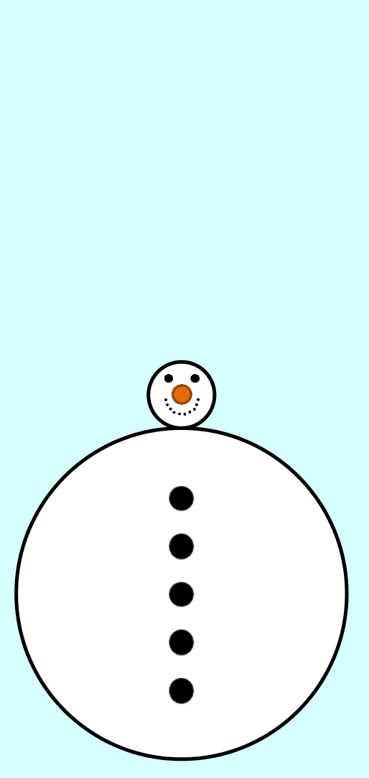
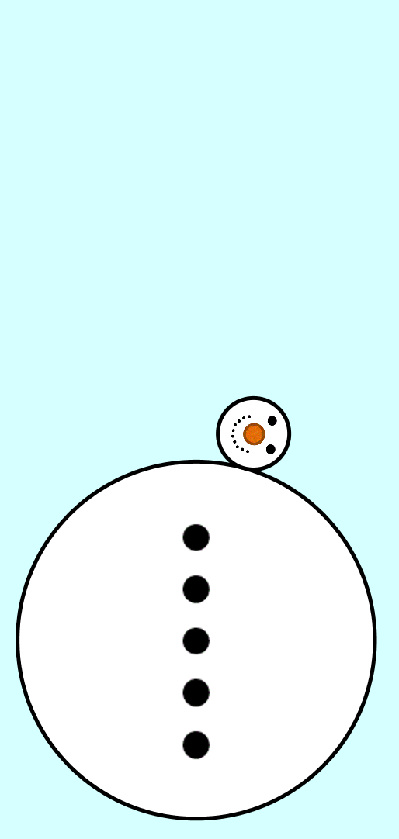
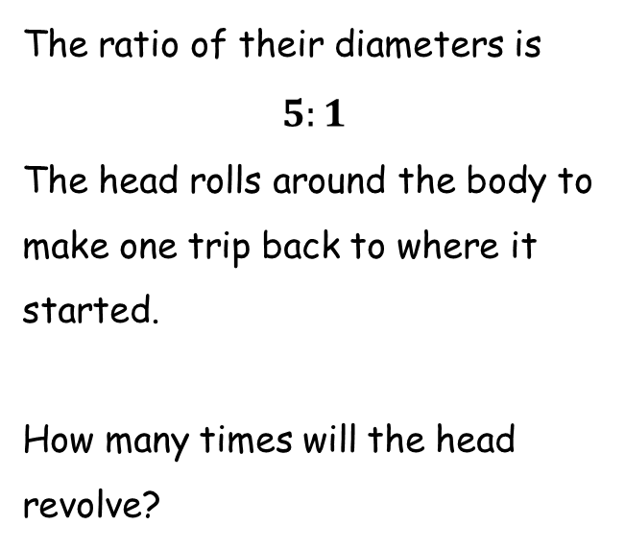
SIC_65
Heads Will Roll!
The head and body of the snowman are circles.
The ratio of their diameters is
$$5:1$$
The head rolls around the body to make one trip back to where it started.
How many times will the head revolve?
Start / Finish Rolling
Drawn
to scale
Notes:
5:1

Slide 43
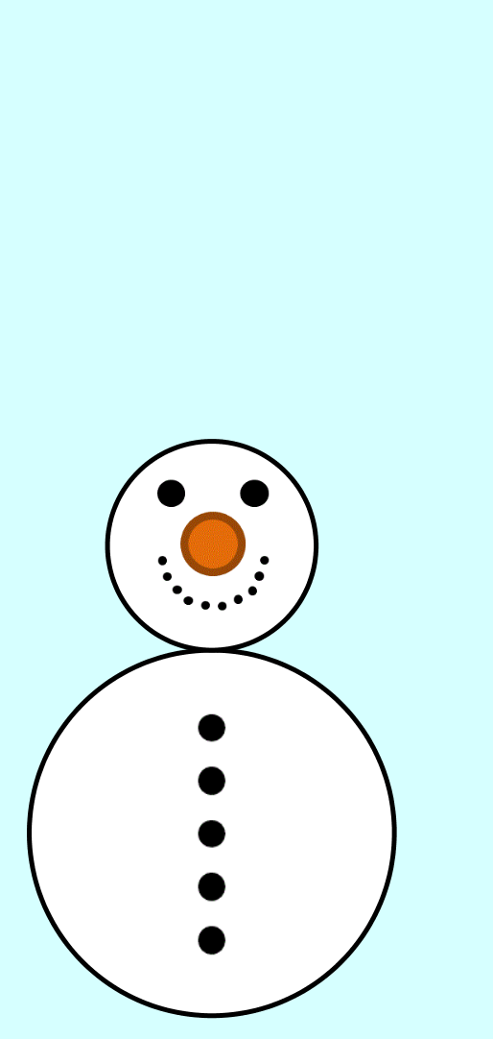
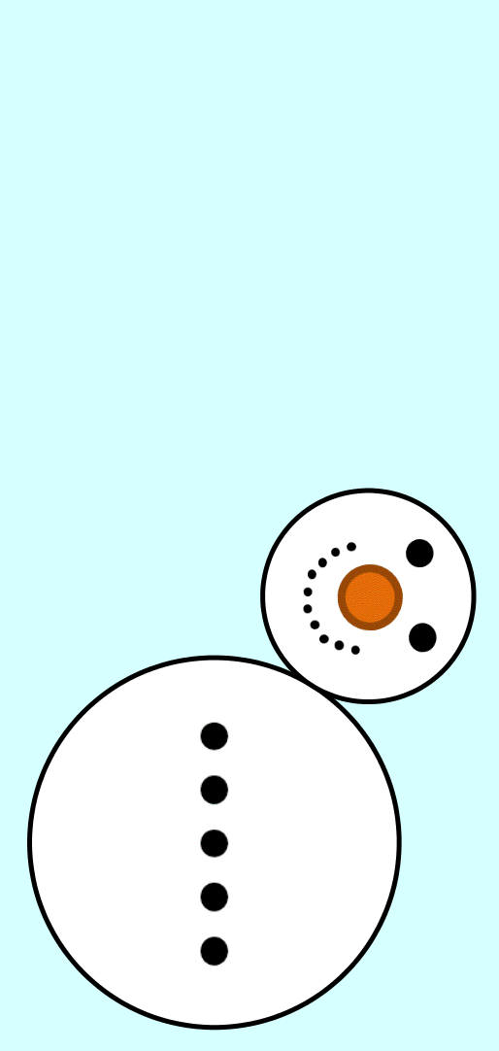
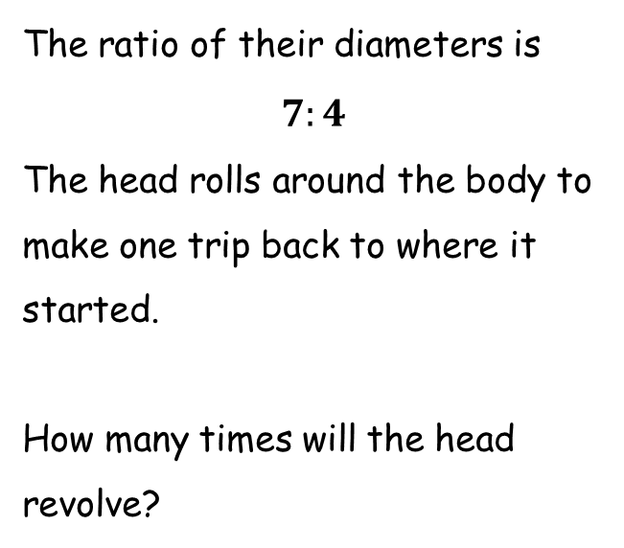
SIC_65
Heads Will Roll!
The head and body of the snowman are circles.
The ratio of their diameters is
$$7:4$$
The head rolls around the body to make one trip back to where it started.
How many times will the head revolve?
Start / Finish Rolling
Drawn
to scale
Notes:
7:4

Slide 44
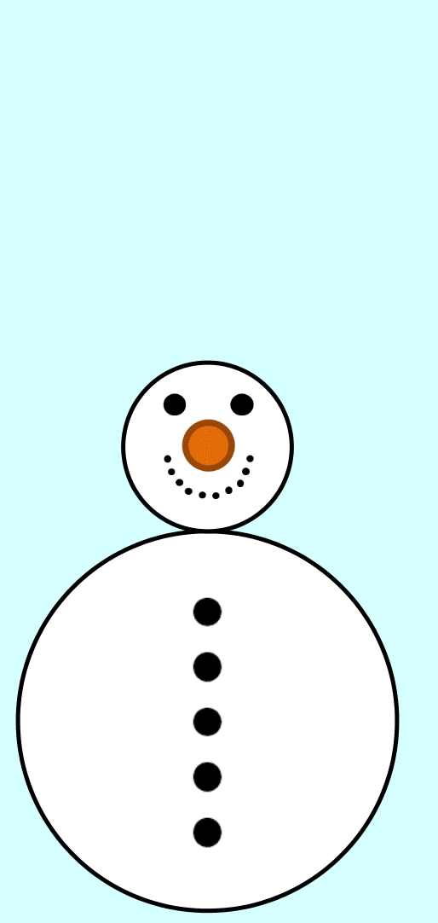
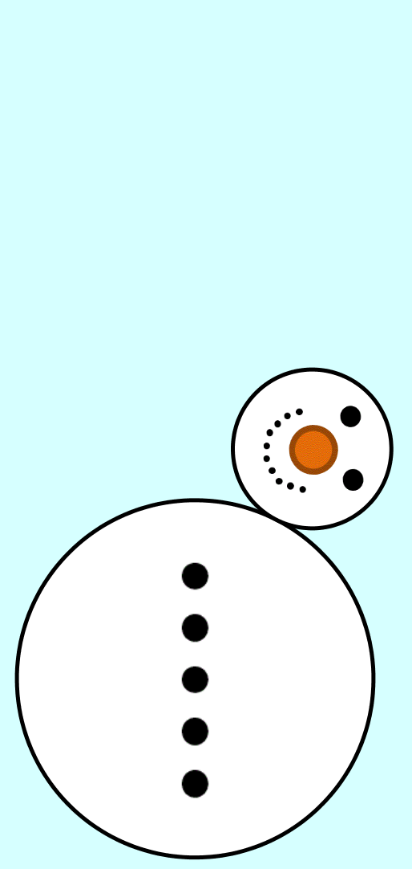
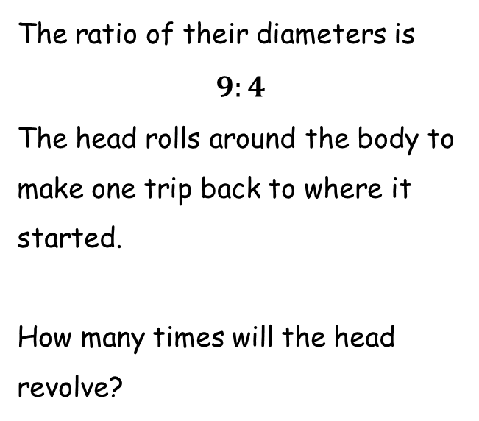
SIC_65
Heads Will Roll!
The head and body of the snowman are circles.
The ratio of their diameters is
$$9:4$$
The head rolls around the body to make one trip back to where it started.
How many times will the head revolve?
Start / Finish Rolling
Drawn
to scale
Notes:
9:4

Slide 45
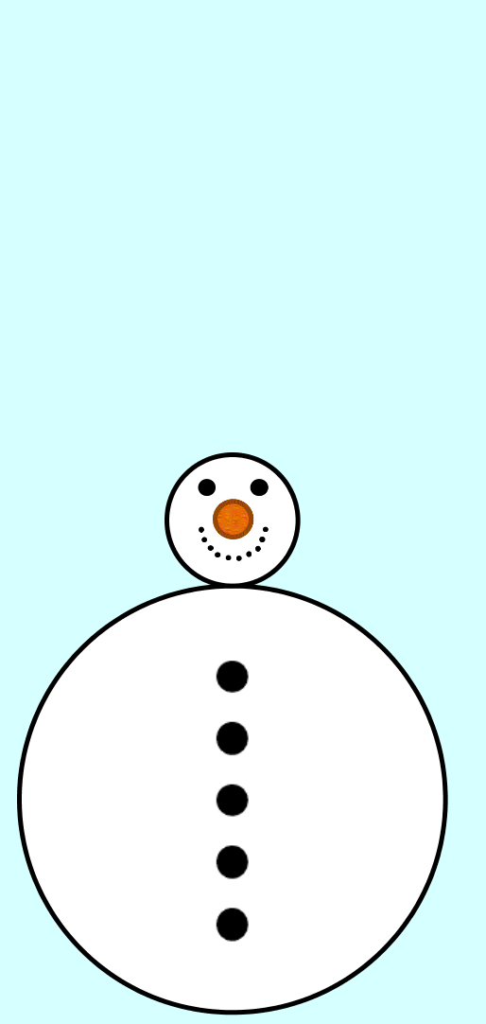


SIC_65
Heads Will Roll!
The head and body of the snowman are circles.
The ratio of their diameters is
$$13:4$$
The head rolls around the body to make one trip back to where it started.
How many times will the head revolve?
Start / Finish Rolling
Drawn
to scale
Notes:
13:4

Slide 46



SIC_65
Heads Will Roll!
The head and body of the snowman are circles.
The ratio of their diameters is
$$15:4$$
The head rolls around the body to make one trip back to where it started.
How many times will the head revolve?
Start / Finish Rolling
Drawn
to scale
Notes:
15:4

Slide 47



SIC_65
Heads Will Roll!
The head and body of the snowman are circles.
The ratio of their diameters is
$$6:1$$
The head rolls around the body to make one trip back to where it started.
How many times will the head revolve?
Start / Finish Rolling
Drawn
to scale
Notes:
6:1

Slide 48



SIC_65
Heads Will Roll!
The head and body of the snowman are circles.
The ratio of their diameters is
$$3:1$$
The head rolls around the body to make one trip back to where it started.
How many times will the head revolve?
Start / Finish Rolling
Drawn
to scale
Notes:
3:1

Slide 49



SIC_65
Heads Will Roll!
The head and body of the snowman are circles.
The ratio of their diameters is
$$2:1$$
The head rolls around the body to make one trip back to where it started.
How many times will the head revolve?
Start / Finish Rolling
Drawn
to scale
Notes:
2:1

Slide 50



SIC_65
Heads Will Roll!
The head and body of the snowman are circles.
The ratio of their diameters is
$$1:1$$
The head rolls around the body to make one trip back to where it started.
How many times will the head revolve?
Start / Finish Rolling
Drawn
to scale
Notes:
1:1

Slide 51



SIC_65
Heads Will Roll!
The head and body of the snowman are circles.
The ratio of their diameters is
$$5:2$$
The head rolls around the body to make one trip back to where it started.
How many times will the head revolve?
Start / Finish Rolling
Drawn
to scale
Notes:
5:2

Slide 53


SIC_65
Heads Will Roll!
The head and body of the snowman are circles.
The ratio of their diameters is
$$4:1$$
The head rolls around the body to make one trip back to where it started.
How many times will the head revolve?
Drawn
to scale

Slide 54


SIC_65
Heads Will Roll!
The head and body of the snowman are circles.
The ratio of their diameters is
$$5:4$$
The head rolls around the body to make one trip back to where it started.
How many times will the head revolve?
Drawn
to scale

Slide 55


SIC_65
Heads Will Roll!
The head and body of the snowman are circles.
The ratio of their diameters is
$$7:2$$
The head rolls around the body to make one trip back to where it started.
How many times will the head revolve?
Drawn
to scale

Slide 56


SIC_65
Heads Will Roll!
The head and body of the snowman are circles.
The ratio of their diameters is
$$9:2$$
The head rolls around the body to make one trip back to where it started.
How many times will the head revolve?
Drawn
to scale

Slide 57


SIC_65
Heads Will Roll!
The head and body of the snowman are circles.
The ratio of their diameters is
$$5:1$$
The head rolls around the body to make one trip back to where it started.
How many times will the head revolve?
Drawn
to scale

Slide 58


SIC_65
Heads Will Roll!
The head and body of the snowman are circles.
The ratio of their diameters is
$$7:4$$
The head rolls around the body to make one trip back to where it started.
How many times will the head revolve?
Drawn
to scale

Slide 59


SIC_65
Heads Will Roll!
The head and body of the snowman are circles.
The ratio of their diameters is
$$9:4$$
The head rolls around the body to make one trip back to where it started.
How many times will the head revolve?
Drawn
to scale

Slide 60


SIC_65
Heads Will Roll!
The head and body of the snowman are circles.
The ratio of their diameters is
$$13:4$$
The head rolls around the body to make one trip back to where it started.
How many times will the head revolve?
Drawn
to scale

Slide 61


SIC_65
Heads Will Roll!
The head and body of the snowman are circles.
The ratio of their diameters is
$$15:4$$
The head rolls around the body to make one trip back to where it started.
How many times will the head revolve?
Drawn
to scale

Slide 62


SIC_65
Heads Will Roll!
The head and body of the snowman are circles.
The ratio of their diameters is
$$6:1$$
The head rolls around the body to make one trip back to where it started.
How many times will the head revolve?
Drawn
to scale

Slide 63


SIC_65
Heads Will Roll!
The head and body of the snowman are circles.
The ratio of their diameters is
$$3:1$$
The head rolls around the body to make one trip back to where it started.
How many times will the head revolve?
Drawn
to scale

Slide 64


SIC_65
Heads Will Roll!
The head and body of the snowman are circles.
The ratio of their diameters is
$$2:1$$
The head rolls around the body to make one trip back to where it started.
How many times will the head revolve?
Drawn
to scale

Slide 65


SIC_65
Heads Will Roll!
The head and body of the snowman are circles.
The ratio of their diameters is
$$1:1$$
The head rolls around the body to make one trip back to where it started.
How many times will the head revolve?
Drawn
to scale

Slide 66


SIC_65
Heads Will Roll!
The head and body of the snowman are circles.
The ratio of their diameters is
$$5:2$$
The head rolls around the body to make one trip back to where it started.
How many times will the head revolve?
Drawn
to scale

